Slide 1
Access for All
Detroit Building Trades Apprenticeship Readiness Program

Slide 2
The Collaborative
The Access for All Apprenticeship Readiness Program is a Detroit area collaborative partnership made up of:
• Community-Based Partners: Southwest Housing Solutions-Greenworks, Detroit Green Door Initiative, and SER Metro - Detroit,
• Joint Apprenticeship Training Committees (JATCs) for eight building and construction trades: Carpenters, Ironworkers, Operating Engineers, Electricians, Cement Masons, Masonry Trades, Pipefitters and Laborers,
• Construction Industry Organizations: Michigan Infrastructure and Transportation Association and MUST (Management and Unions Working Together)
• Union Construction Industry Contractors: Adamo Group, Angelo Iafrate construction, Barton Mallow, Blaze Contracting, The Brinker Group, C.A. Hull, Cadillac Asphalt, Dan’s Excavating, Edgewood Electric, Hale Contracting, Toebe Construction, Tooles Group, Walbridge, Ajax Paving, and Motor City Electric.

Slide 3
The Collaborative
a State Agency, (Michigan Department of Transportation),
a private, non-profit workforce development organizations, Detroit Regional Workforce Fund and Michigan State AFL-CIO Human Resources Development, Inc. (Michigan HRDI),
Detroit Regional Workforce Fund – a collaborative of private philanthropic and public funders with an operating staff focused on workforce innovation. The DRWF supported the early research and development and the demonstration cohorts as well as project evaluation through 2016.

Slide 4
Community Based Organizations
Services Delivery Roles

Slide 5
Customer Process Flow
Created to:
Ensures a single point of entry for Access for All participants
Ensures
Ensures the seamless delivery of services for the consumer
*CBO Manager (SER Metro-Detroit) manages and coordinates CBO outreach/recruitment, intake and screening, continuum of participant support, and retention activities

Slide 6
Recruitment & Outreach
SER Metro-Detroit, (SER)
Coordinates outreach & recruitment for Access for All
Community based partners (Southwest Solutions and Green Door Initiative) and labor partners are referral sources
Intake/Screening
Obtains eligibility/enrollment documents.
SER completes intake assessments to ensure qualified applicants will be considered for enrollment in Access for All
All screening & assessment activities occur at SER
Assessment
Work Keys Assessments
Workshops – SER & SW Solutions will offer a Financial Literacy Workshop to all candidates (one of the three workshops)
SER provides referrals for drug screening, physical assessment and conducts criminal background checks

Slide 7
Apprenticeship Readiness Training Component
The Green Door Initiative delivers Roots of Success Training
Training is designed to increase environmental literacy, academic literacy and job readiness skills
Continuum of Participant Support
Provided by SER and Southwest Housing Solutions- through the Center for Working Families (CWF), all participants will receive financial education, coaching, and assistance accessing public benefits and income supports to address any barriers to successful program completion!
SER & SW Solutions will each enroll one Access for All cohort in the CWF
Case Management (SER) – Participants received on going coaching from the SER Career Coach
Job Coaching (SER)- will be provided by a Job Coach Mentor (must be union affiliated) to ensure participants make a successful transition into apprenticeships
Mentoring specific to the trades is provided to participants by the Bricklayers.
Retention & Follow Up
Retention and follow up services will be provided for three year’s and are coordinated through SER and SW as part of services provided through the CWF

Slide 8
Access for All Apprenticeship Readiness
Training Purpose:
Provide Detroit residents with the skill sets required to enter the Construction Industry.
Safety, Productivity and Quality

Slide 9
Access for All Apprenticeship Readiness
9 – Week Apprenticeship Readiness Program
Training Components Include:
Certifications • OSHA – 30 First Aid / CPR/ AED Code of Conduct | Workkeys Locating Information Blueprint Reading Field Trips (5)
Math • Fractions / Decimals • Measurement • Geometry • Algebra Construction Worksite Computers and the Trades Strength & Ergonomics | Essential Employment Skills • Communication • Constructive Feedback • Listening / Following Directions • Teambuilding • Problem-Solving • Conflict Resolution

Slide 10
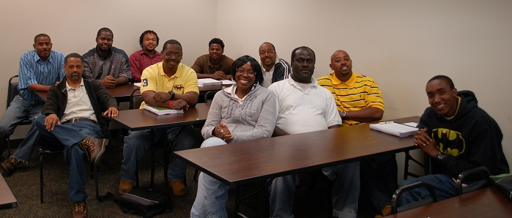
First Graduation Class
July 24, 2014

Slide 11
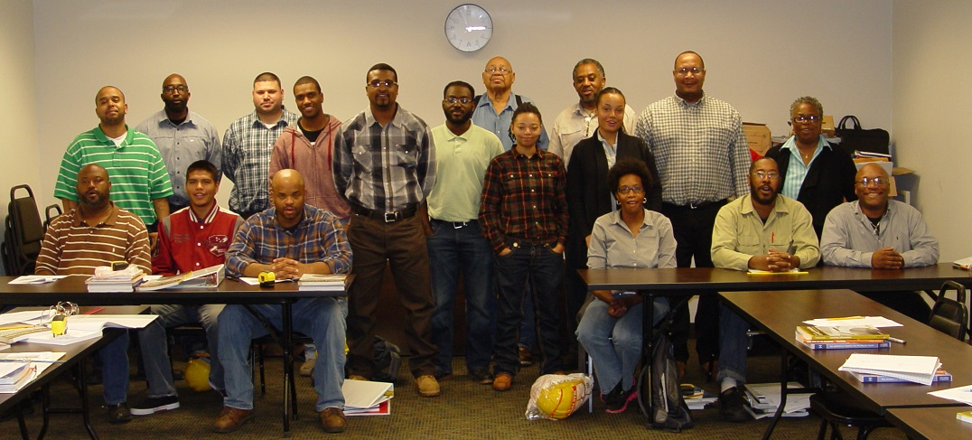
Second Graduation Class
December 11, 2004

Slide 12
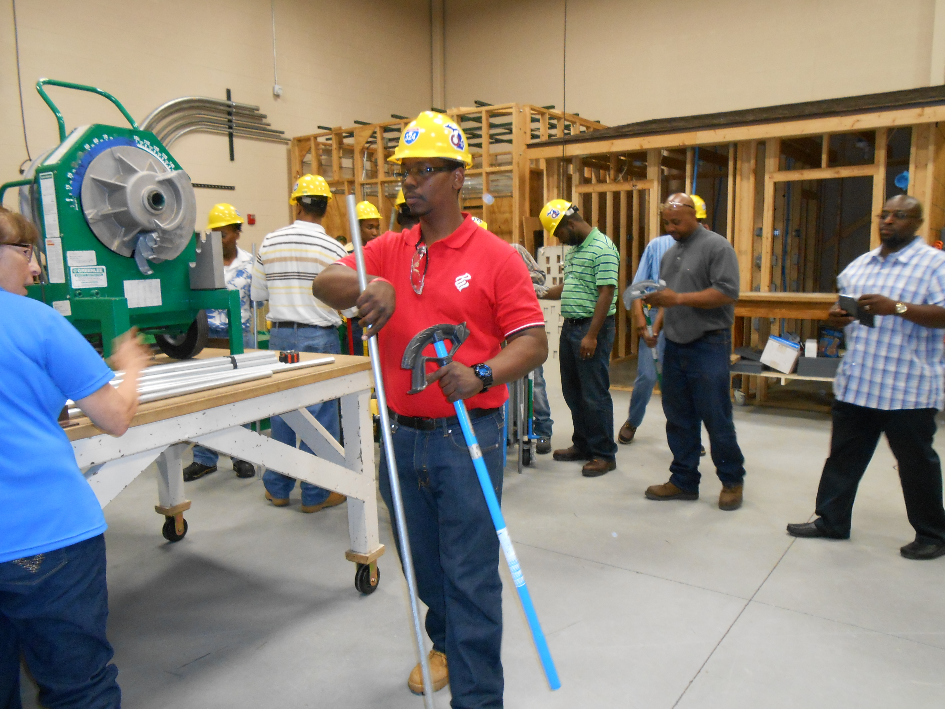
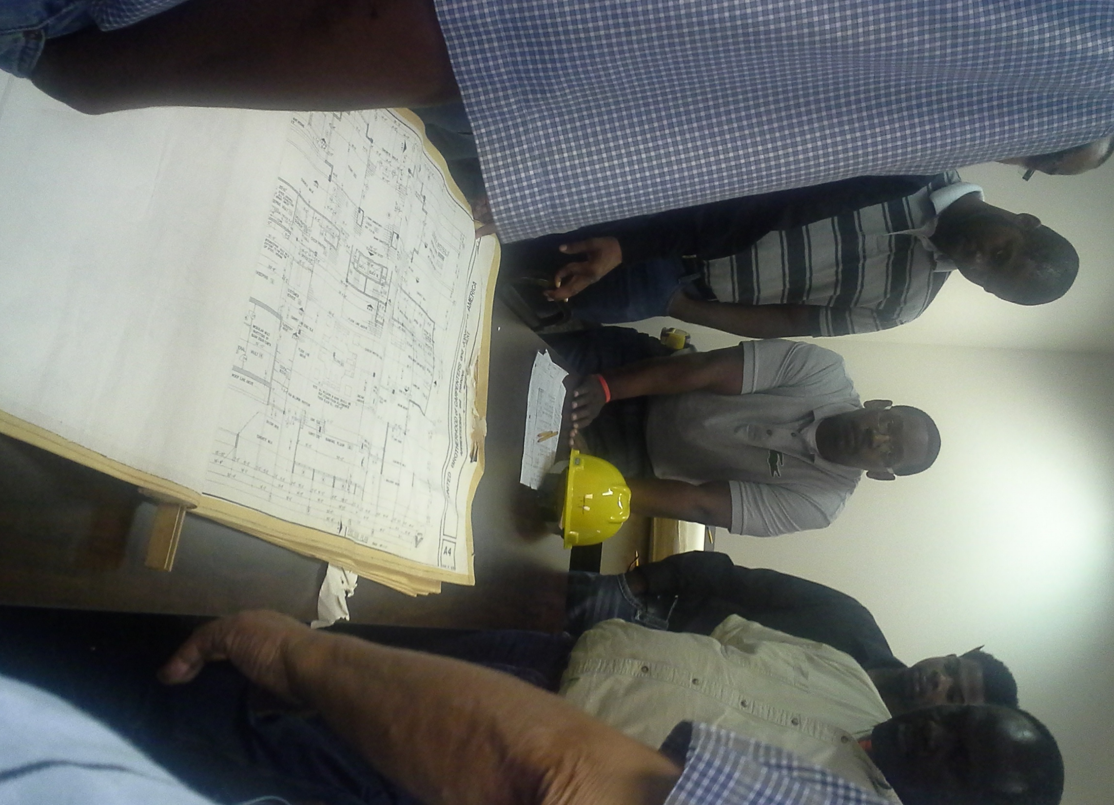
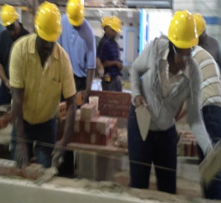
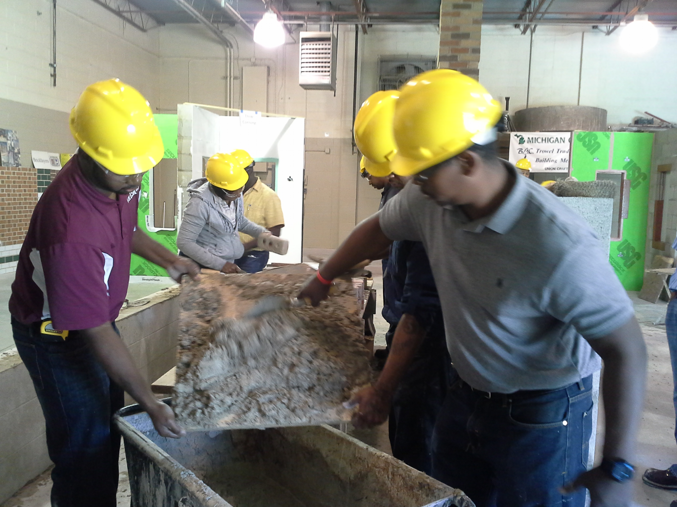
Class in Action

Slide 13
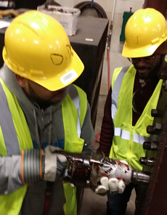
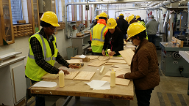
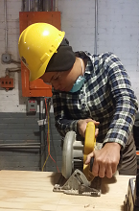
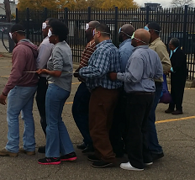
More Action

Slide 14
Other Recruitment Efforts
Career Technical Education – D.P.S. A. Phillip Randolph
Summer Work Opportunity – City of Detroit
Exploration – Rehab. and construction of residential properties
Explorers Program
MDOT Community Program
District Detroit Initiative
Greater engagement K-12

Slide 15
Thank you!

Slide 16
Erin Duckett Michigan Workforce Development Agency
How To Connect

Slide 17
Key Players
Federal
Congress
U.S. Department of Labor
Regional Office - Chicago
U.S. Department of Health & Human Services
State
Governor
Governor’s Talent Investment Board (GTIB)
State Agencies – WDA
Locals
LEO
WDB
MWAs
One Stop Operator
Michigan Works! Association
Partner Agencies
Legislature

Slide 18
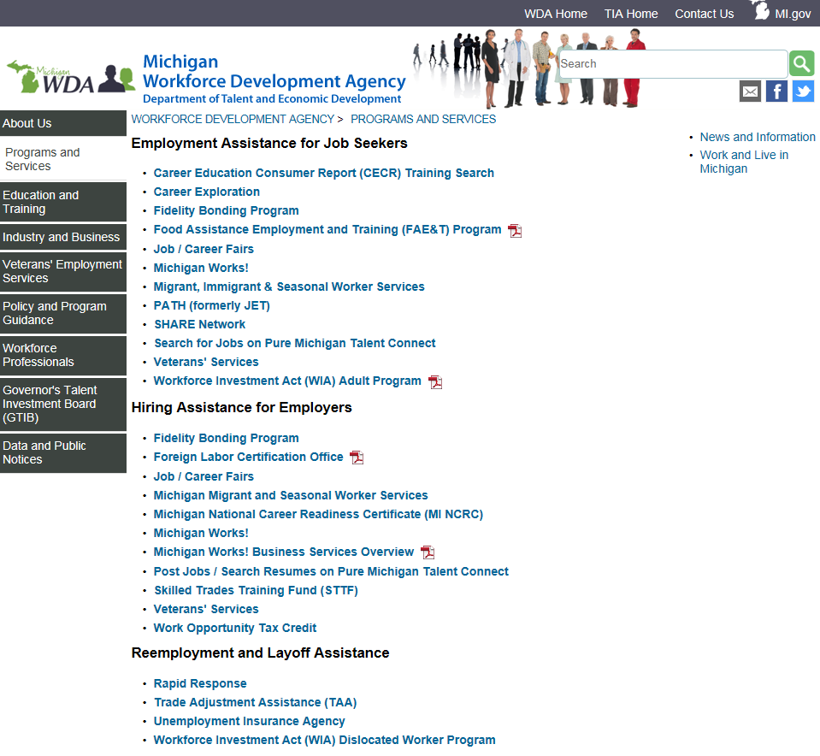
How To Connect – www.michigan.gov/wda
www.michigan.gov/wda

Slide 19
Michigan Works! Association
Established in 1987 to provide services and support to Michigan’s Workforce Development System
First unified workforce development system in the country
Is a non-profit membership organization that supports the Michigan Works! system
Connects members with resources to help them better serve employers and job seekers
Members include:
MWAs
MWA Board Chairs
Chief Elected Officials
Associate Members
Services provided:
Advocacy and participation in the legislative process
Convenes meetings as a way for members to network and share best practices
Creates events to promote the System

Slide 20
Michigan Works! Agencies
Provide administrative support for the local WDB
Partner with the State
May provide direct services, may contract services, or a combination of both
Ensure local plan/priorities are followed
Negotiate performance levels with the state, in conjunction with LEO and WDB
Ensure performance measures are met
Provide oversight of local contractors
Provide training and technical assistance to local contractors
Answer to the local WDB
Are the direct contact for subcontractor questions

Slide 21
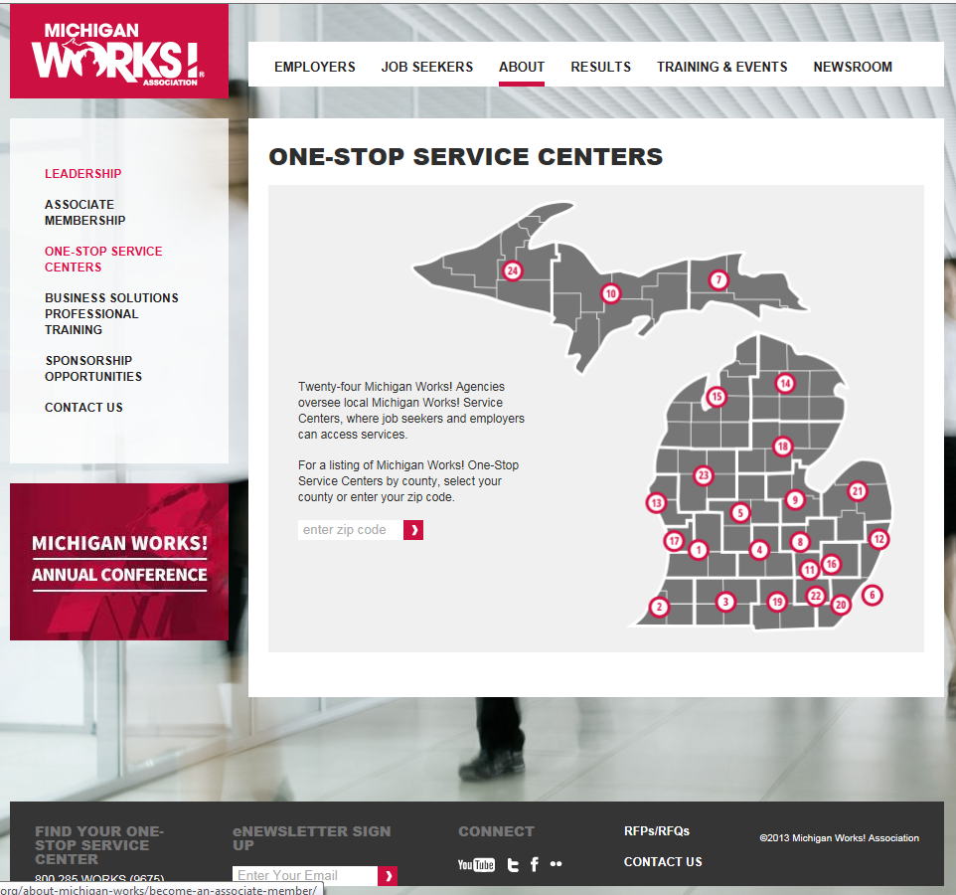
How To Connect – http://michiganworks.org
www.michigan.gov/wda

Slide 22
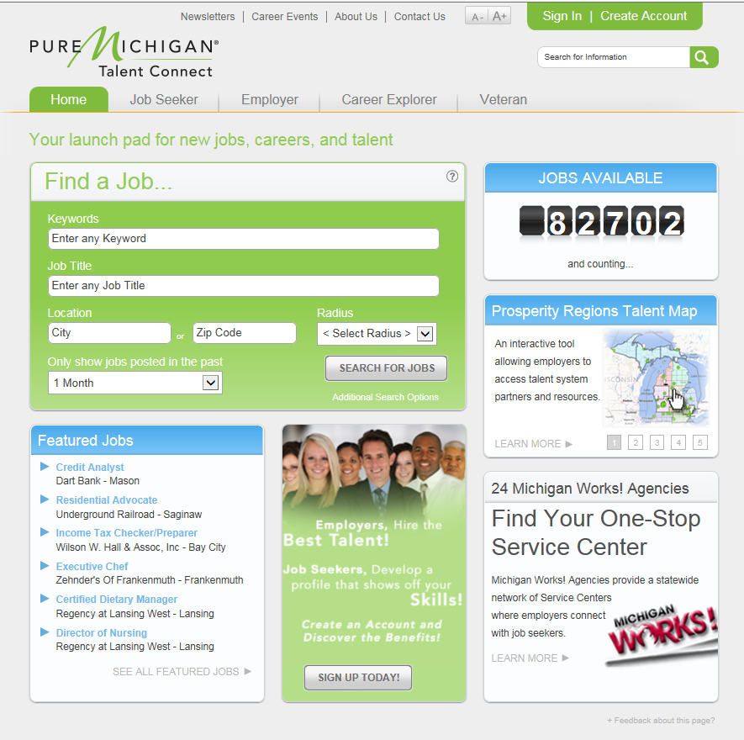
How To Connect – www.mitalent.org
www.michigan.gov/wda

Slide 23
Questions
Erin Duckett
Workforce Development Agency
DuckettE@michigan.gov
(517) 335-4414

