Slide 1
A Simplified Pavement Design Tool
APAM Local Road Workshop
March 2015

Slide 2
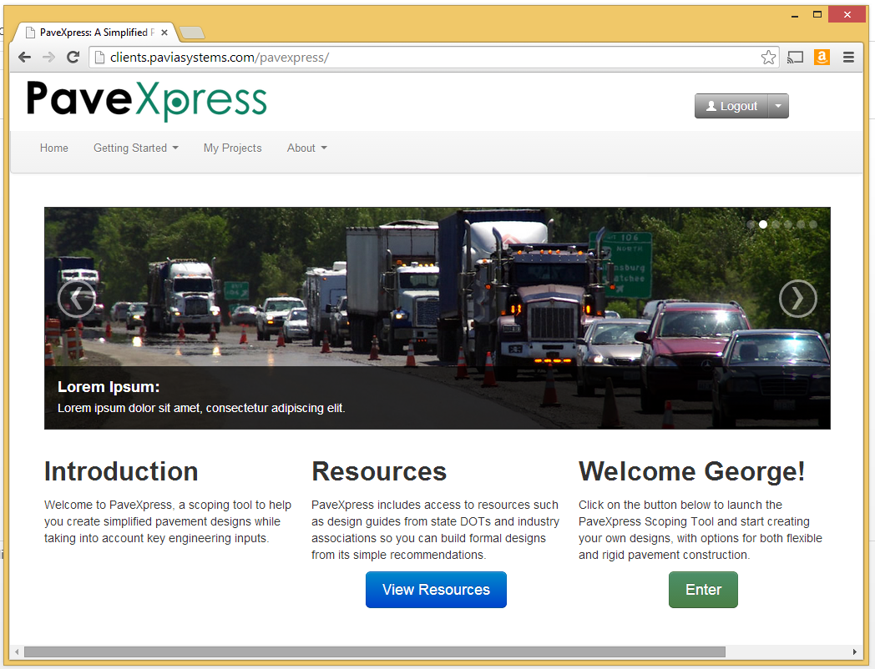
Today’s Agenda
Why PaveXpress?
An Introduction
Overview of system
Design scenarios using PaveXpress
What is happening next

Slide 3
We’ve got a lot of roads
http://www.fhwa.dot.gov/planning/images/thnhsjpg.jpg
Notes:
There are over 4 million miles of roadway in the United States according to the Federal Highway Administration. Of that, almost 3 million miles, are located in rural areas, with the remaining located in urban areas. While State and Federal agencies are responsible for a portion of those miles, there are over 39,000 local government agencies that must manage, maintain, and improve over 3.17 million miles of road or 77.5 percent of all roads in this country.

Slide 4
Examples of over and under-designed pavement abound
Photos courtesy of WSDOT
Notes:
This amounts to a great diversity of local practices, procedures, and policies when it comes to determining the right pavement design for a given road. Why is this important? Selecting the right pavement design can have long lasting impacts on a road owner’s ability to manage and maintain the road they have within the resources available. Over designed pavements reduce the funds available for other projects; under designed pavements lead to pre-mature failures and costly maintenance expenses
Optional:
Examples of over and under-designed pavements exist across the country. For instance, two different projects in one community with the same traffic varied in asphalt thickness by two inches. Both projects were constructed on an aggregate base and compacted native subgrade. The first project had pre-mature failures within the first two years of service and led to extensive patching. To complicate matters, the project had utilities and curb and gutter which restricted an overlay. The second project with the two additional inches of asphalt has had no failures. While the initial cost was slightly higher, the structural life of the pavement was four times longer and allowed maintenance funds to be spent on the underperforming project.

Slide 5
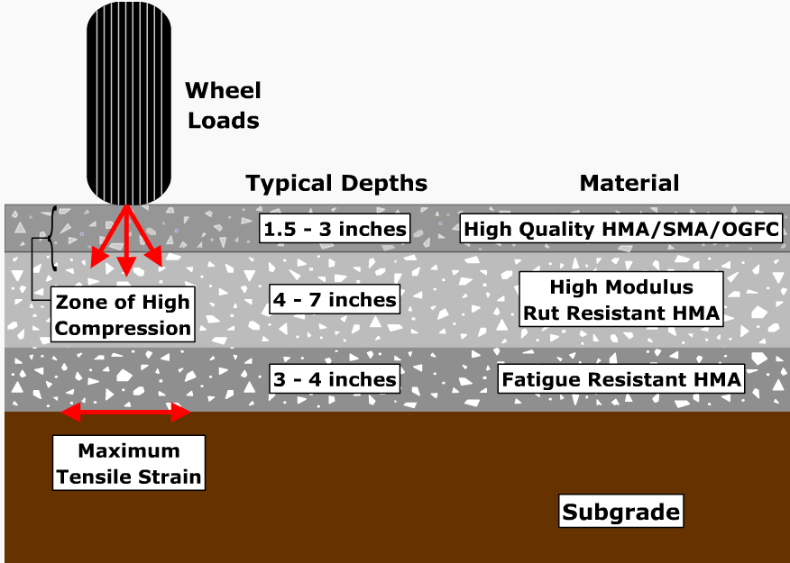
Perpetual pavement design is a long lasting approach
Pavement Interactive
Notes:
As an example “Perpetual Pavement” is a term used to describe a long-lasting structural design, construction and maintenance concept for HMA pavements. If properly maintained and rehabilitated, a perpetual pavement can be designed and built to last longer than 50 years without requiring major structural rehabilitation or reconstruction, and needing only periodic surface renewal in response to distresses confined to the top of the pavement. - See more at: http://www.pavementinteractive.org/article/perpetual-pavements/#sthash.TtPIMOVW.dpuf

Slide 6
AASHTO has been developing MEPDG for high volume roads, but a gap has developed for local roads and lower volumes
Pavement Interactive
Notes:
For the past 15 years, the American Association of State Highway and Transportation Officials (AASHTO) have been developing a new pavement design methodology for use by state highway agencies (SHAs) known as the Mechanistic-Empirical Pavement Design Guide (MEPDG). While an improved approach to design high truck volume pavements for SHAs, the practicality and applicability to local agencies and consultants for low volume road designs are questionable.
Many agencies have long been comfortable with the 1993 AASHTO Guide for the Design of Pavement Structures and the associated software known as DARWinTM. However, the DARWinTM software is no longer available and local agencies and consultants were faced with a lack of well supported pavement design tools in the marketplace.

Slide 7
PaveXpress Objectives
Provide tool to develop technically sound pavement designs for roadway pavements
Provide a user-friendly, visually appealing, pavement design tool accessible to users on a variety of devices
Provide a free application for conducting pavement designs following 1993/1998 AASHTO
Provide resources to enhance understanding and comfort with asphalt pavement design
Notes:
To combat this enormous shortfall, NAPA and the State Asphalt Pavement Associations (SAPA) formed a Task Group to engage with stakeholders and identify, as well as prioritize the needs of the community in this area. The NAPA/SAPA Task group then identified the following key objectives of such an effort:
Provide tool to develop technically sound pavement designs for roadway pavements
Provide a user-friendly, visually appealing, pavement design tool accessible to users on a variety of devices
Provide a free application for conducting pavement designs following 1993/1998 AASHTO, with opportunities to expand into other areas
Provide resources to enhance understanding and comfort with asphalt pavement design

Slide 8
Target Audience
Local Agencies
A/E/C Firms
Engineering Students
Non-Pavement Design Specific Engineers!
Notes:
In terms of looking at who was targeted for use of this tool, it really was to focus on those 3 million miles of roads that local agencies have to manage and maintain. This includes the agencies themselves, consulting firms asked to help develop designs, and of course students who will need this knowledge to enter in to the field. In other words, the folks that aren’t able to specialize in pavement design.

Slide 9
Guiding Principles
Provide accurate un-biased results…be a trusted resource
Only ask the user for what is required to perform a technically sound design
Where appropriate suggest industry accepted defaults to minimize user input
Provide context sensitive help and guidance
Assume users aren’t pavement design experts
Notes:
Several guiding principles were laid out during the process. First and most importantly, the new pavement design tool had to be unbiased and based on nationally accepted methodologies. The Task Group believed following the 1993 AASHTO and 1998 AASHTO Supplement to the Guide for the Design of Pavement Structures would provide the credibility to gain acceptance for local agencies and consultants, because they had been the industry standards effectively used for years. Second, the product must be easy to use. Many people who design pavements are not fulltime pavement engineers, so the application must be able to step the user through the design process logically and only request user input where needed. Third, the software must provide industry suggested default values where applicable. However, the user had to have the ability to override the suggested defaults. And finally, the system must be able to provide context sensitive Help for the user.

Slide 10
I don’t always do pavement designs, but when I do, I prefer PaveXpress.
Image from themostinterestingblogintheworld.com
Notes:
That is to say, like the most interesting man in the world, I don’t always do pavement designs, but when I do I prefer PaveXpress.

Slide 11
Approach: Web Delivery
Browser based delivery
Available via the web
Supports all kinds of devices/OS
Desktops
Laptops
Tablets (7” – 10” - includes iPad Mini on up.
Handheld device capabilities
Easily scalable and updatable
Notes:
The approach here was to develop a tool that can be broadly accessible on a multitude of devices with minimum support related issues. That meant a responsive web delivery that can be viewed on devices like iPads, laptops, and even phones and still work. What does that mean for you? You can access your designs from any computer that has internet access, won’t have installation headaches or software version licensing, and are on a platform that is easily updatable. This is key, as you’ll see later, to help ensure you’re able to use the latest.

Slide 12
Approach: Technical
Provide technically sound designs using:
Flexible: AASHTO ’93
Rigid: AASHTO ‘93 w/ ‘98 Supplement
Parking lot guidance (Flexible only)
Use industry accepted standards and guidance
Linkages to State and Local guidance
Linkages to Pavement Interactive
Notes:
The pavement design procedure within the software currently uses an empirical approach, meaning that the relationship between design inputs (e.g., loads, materials, layer configurations and environment) and pavement failure were arrived at through experience, experimentation or a combination of both. Specifically, PaveXpress uses the 1993 AASHTO Guide for the Design of Pavement Structures for Flexible Pavements design and the 1998 Supplement to the AASHTO Guide for the Design of Pavement Structures for Rigid Pavement designs. Is addition, there is parking lot design guidance for both low volume (parking stall) and higher volume (truck lanes) as well. The application uses industry accepted standards and guidance to help you navigate through the design process and provides linkages to key state and local resources to help refine your design. Finally, the site contains linkages to Pavement Interactive to explain terms, concepts and illustrate the practice. As a show of hands, how many of you are familiar with this tool? <get count>

Slide 13
Let’s take a Closer look!
A sneak preview at some of the highlights.
Notes:
The outcome of these efforts recently resulted in the launch of PaveXpress, a simplified pavement design tool. PaveXpress is a free, web-based pavement design tool that creates technically sound pavement structural designs for both flexible and rigid pavements. The web-based software is available for use by local agencies, engineers, architects, consultants, and engineering students who need a reliable way to quickly determine the necessary pavement thickness for a given section of roadway or project, even when faced with little information about the roadway section.
Let’s take a closer look!

Slide 14
Home page: Welcome to PaveXpress

Slide 15
Navigation up top, resources to familiarize you

Slide 16
Background Information is available

Slide 17
Linked and integrated to Pavement Interactive

Slide 18
Frequently asked questions

Slide 19
You must register with email and password.

Slide 20
Once logged in, go to My Projects to view your designs
Notes:
A key benefit of using PaveXpress is that all pavement designs are securely saved and accessible via any computer that has an internet connection. This includes access for tablets and mobile devices. This provides users a ton of flexibility in how they access and share the pavement designs they have created. It also help maintain a central repository of all pavement designs that a given user or agency may want to keep over time.

Slide 21
Create and manage your folders of designs

Slide 22
Create a new project and design at the click of a button
Notes:
A key benefit of using PaveXpress is that all pavement designs are securely saved and accessible via any computer that has an internet connection. This includes access for tablets and mobile devices. This provides users a ton of flexibility in how they access and share the pavement designs they have created. It also help maintain a central repository of all pavement designs that a given user or agency may want to keep over time.

Slide 23
Give it a name and location

Slide 24
A clean, step wise process for creating the design

Slide 25
1. Start with general project information, locations
Notes:
To use PaveXpress, users need only gather some basic information about the roadway section in question.
Context-sensitive help and guidance are available at every step of the design process to aid users, meaning users can always drill down to better understand the impacts of changing a design parameter on the design outcome. PaveXpress also includes links to state and local guidance, as well as to Pavement Interactive, a free online resource for all things pavement originally developed by the University of Washington and delivered by Pavia Systems to ensure the right pavement is being selected for the job.
ement designs, and it suggests industry-accepted defaults where appropriate.

Slide 26
2. Expand into design parameters

Slide 27
Context sensitive help linked to resources throughout

Slide 28
Enter traffic and loading information

Slide 29
Calculate traffic from AADT using AASHTO methods

Slide 30
Completion year traffic is set, now on to LEF

Slide 31
Create composite load equivalency factor

Slide 32
Specify your surface layer information

Slide 33
Warnings where appropriate to alert of changes

Slide 34
Enter your base layer and subgrade information

Slide 35
Add multiple base layers if needed

Slide 36
And enter your subgrade…can use conversion tables

Slide 37
And voila…a design and resources are available

Slide 38
And the calculations are shown

Slide 39
Iterate back and forth to check sensitivity, add layers

Slide 40
For Rigid, a similar process with a few alterations

Slide 41
Additional design parameters for weather

Slide 42
Specify the surface characteristics

Slide 43
Specify the base characteristics

Slide 44
Click, and a design is presented with calculations

Slide 45
Parking lots you ask?

Slide 46
Light duty points directly to local guidance (catalogs)

Slide 47
Takes you to local guidance from MAPA

Slide 48
Some other capabilities you should be aware of

Slide 49
Organize, store, and print your designs

Slide 50
Share your design directly from PaveXpress via email
Notes:
In addition, all PaveXpress projects can be printed, shared, and saved, and design options can also easily be evaluated in a side-by-side comparison tool included within PaveXpress.

Slide 51
Compare up to 3 designs side by side

Slide 52
Roadmap for PaveXpress
A framework to continue to build upon:
Version 1.0: Basic AASHTO 93/98 for flexible and rigid
Launched late 2014
Version 1.1: Layer Protection
Just launched on Monday
Version 2.0: Overlay Design (empirical)
Coming Q2
Version 3.0: Simplified mechanistic design for both new construction and overlays
Notes:
To continue to address the needs of the community, there are a number of planned updates coming soon to PaveXpress. Recognizing much of the pavement work being performed today is in the areas of maintenance and rehabilitation, the next version of PaveXpress will allow the user the capability to assess an existing pavement’s structural condition and then develop an appropriate overlay design to rehabilitate it. Likewise, some new or rehabilitation projects may warrant more sophisticated pavement analysis to address traffic or other concerns. A nationally recognized mechanistic-based pavement design approach will be added to complement the existing AASHTO empirical design method for flexible pavements to give the users the option of comparing outcomes and increasing their confidence in the objectivity of the result.
Updates will be deployed automatically over the web, making them immediately available to users without installation headaches. Registered users of PaveXpress will be notified by email. That means each time you log in and use PaveXpress, you may already have access to these additional tools and more.

Slide 53
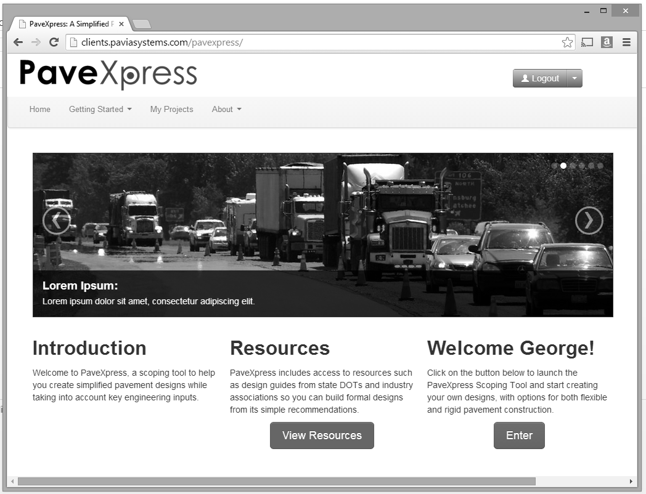
A Simplified Pavement Design Tool
www.pavexpressdesign.com
Notes:
You can access the website by visiting www.pavexpressdesign.com
In addition, NAPA has conducted a couple of webinars on PaveXpress that goes into more detail around specific designs. Should you want to view that it is freely available on NAPA’s website by going to the NAPA Talks Webinar Series links.
we always welcome feedback or questions. You can get a hold of George using the email below for more information or by using the contact email on the website directly.
Thanks,

