Slide 1
Mechanistic-Empirical Pavement Design Implementation in Michigan
APAM Annual Paving Conference
April 21-22, 2015
Mt. Pleasant, MI
Michael Eacker, MDOT
Justin Schenkel, MDOT

Slide 2
Outline
What is ME?
ME Timeline/Work to Date
Calibration
MDOT Implementation/Transition
Preliminary Phase Design Results
Transition Phase 1
ME Webpage

Slide 3
What is ME?

Slide 4
What is ME?
Mechanistic-Empirical pavement design (ME) is the latest generation of pavement design methodology
Mechanistic: uses the theory of mechanics - pavement response (stresses/strains) to applied load
Empirical: observations (actual performance) used to calibrate the mechanistic models

Slide 5



What is ME?
EICM*
* - Enhanced Integrated Climatic Model
Traffic
Structure
Climate
& Materials
Transfer
Functions
Mechanistic
Predicted
Analysis
Performance

Slide 6
What is ME?
 | AASHTO 1993 | Mechanistic-Empirical
Basis | Empirical observation from the 1958-59 AASHO Road Test | Theories of mechanics
Original Calibration | AASHO Road Test – Ottawa, Illinois | SHRP test sections from around the country
Traffic Characterization | Equivalent Single Axle Load | Axle load spectra
Materials Inputs | Very few | Many
Climatic Effects | Limited – can change inputs based on season | Integral – weather data from 600+ US weather stations included
Performance Parameter | Present Serviceability Index | Various distresses, IRI
Output | Thickness | Performance prediction (distress prediction)

Slide 7
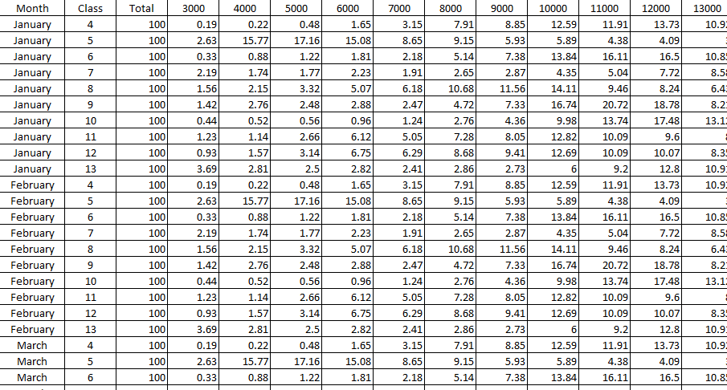
What is ME?
Axle Load Spectra

Slide 8
What is ME?
Examples of new materials inputs
    Gradations, liquid limit, plasticity index, optimum water content, etc. of base/subbase/subgrade
    Thermal properties of the paved surface (expansion, conductivity, heat capacity)
    Concrete shrinkage (ultimate, reversible, and time to 50%), unit weight, cement content, water to cement ratio, etc.
    HMA air voids, binder content, unit weight, dynamic modulus, creep compliance, IDT, etc.

Slide 9
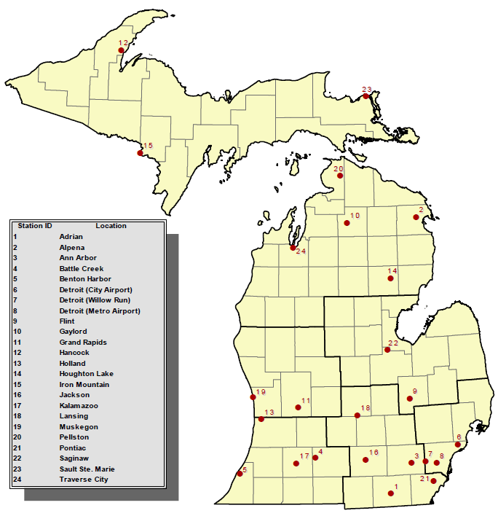
What is ME?
Weather Stations

Slide 10
What is ME?
Distresses (performance) predicted over time
  HMA distresses
    Transverse cracking
    Longitudinal cracking (top-down)
    Fatigue cracking (bottom-up)
    Rutting
    IRI
  Concrete distresses
    % slabs cracked
    Faulting
    IRI

Slide 11
What is ME?
Iterative design process:
  Enter initial cross-section
  Run the design
  Review the results
  Adjust as necessary until an acceptable design is found

Slide 12
ME Timeline/ Work to Date

Slide 13
ME Timeline
AASHTO Pavement Design Guide includes recommendation to move toward mechanistic design
NCHRP project 1-37A (“AASHTO 2002”) begins
NCHRP project 1-37A completed
Version 0.8 of the software
1986
1998
2004
2005
2006
Evaluation of 1-37A Project
MDOT Research →
Concrete CTE Project

Slide 14
ME Timeline
Version 1.0 of the software released
Accepted as AASHTO’s interim design method
Development of commercial version of software (2.0) begins
DARWin-ME becomes available from AASHTO
Software re-branded as Pavement ME Design
2007
2008
2009
2010
2011
2012
2013
2014
Evaluation of 1-37A Project
HMA Characterization
Packaged as one project
Concrete CTE Project
Rehab Design Sensitivity
Traffic Characterization Project
ME Calibration
Subgrade Resilient Modulus Project
Unbound Materials Resilient Modulus Project

Slide 15
Work To Date
Other on going work
Improvement of Michigan Climatic Files in Pavement ME Design
  Current research project with completion date of April 30, 2015
  Clean up the data
    Fill in missing months
    Correct errors
  Add additional years of data
  Sensitivity to weather stations, weather data, and number of years of data
  Recommend locations for new stations

Slide 16
Work To Date
Traffic and Data Preparation for AASHTO MEPDG Analysis and Design
  National pooled fund study
  Developed software for converting PTR data to ME inputs (replaces TrafLoad)
  Also runs quality checks on the data and tools for repairing/improving the data

Slide 17
Work To Date
ME Oversight Committee
  Goal: Facilitate the implementation of ME as MDOT’s standard design method
  Facilitate business process changes for pavement design
  Help with decisions on design criteria
  Help with decisions on input values
  Expand department knowledge of the software and the impacts of different inputs and design decisions
  Explore research needs
  Facilitate industry participation

Slide 18
Work To Date
ME Oversight Committee (cont.)
  Membership from various areas
    Supervisors of the following general areas:
      Pavement management
      HMA materials
      Concrete materials
      Aggregate materials
      Pavement evaluation
      Traffic monitoring
    Pavement Operations Engineer
    Pavement Design Engineer (chair)
    Region Soils Engineers (Region pavement designers)
    Concrete and HMA paving industries

Slide 19
Calibration

Slide 20
Calibration
Concept: Use Michigan Pavement Management System (PMS) data and project specific inputs to calibrate the ME distress prediction models
Goal: Minimize the error between observed and predicted distresses, and eliminate bias

Slide 21
Calibration
Predicted
We want the data to plot as close as possible to this line
Measured

Slide 22
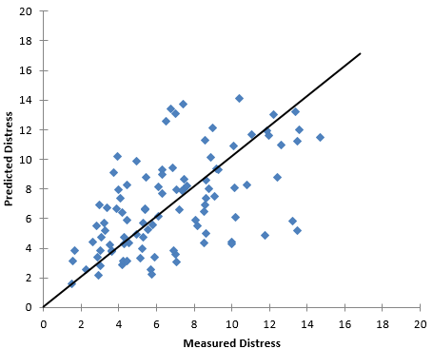
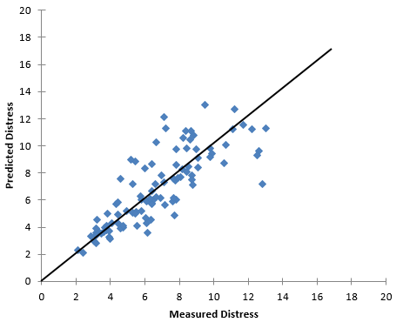
Calibration
Example of minimizing error

Slide 23
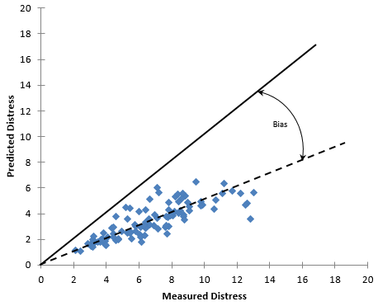
Calibration
Example of bias

Slide 24
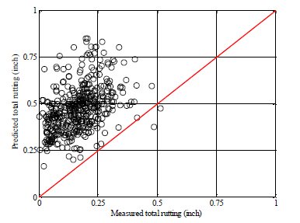
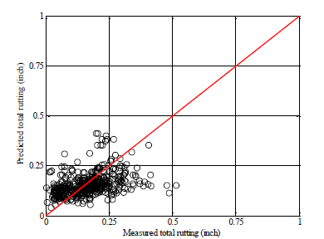
Calibration
Default Calibration
Michigan Calibration
Source: Final report RC1595

Slide 25
Calibration
Conducted by Michigan State University
Projects involved in calibration:
  HMA reconstruct – 85
  Concrete reconstruct – 20
  Rubblize – 11
  Unbonded concrete overlay – 8
  Crush and shape – 23
  HMA overlay – 22
LTPP projects from Michigan, Ohio, and Indiana were added in to see if the calibration could be improved

Slide 26
Calibration
Reviewed construction projects records from long-term storage for materials inputs
Used as many as-constructed inputs as possible to create ME designs for all projects used for calibration
Predicted distresses pulled from the ME results and compared to the observed data
Were able to improve all distress models

Slide 27
Implementation/Transition

Slide 28
Implementation/Transition
Transition Phases:
  Preliminary phase – ME designs of recent life-cycle projects
  Phase 1 – newly submitted life-cycle and APB reconstruct projects
  Phase 2 – Region-designed reconstruct projects
  Phase 3 – newly submitted life-cycle rehab projects
  Phase 4 – Region-designed rehab projects
  Phase 5 – final recommendations for full implementation

Slide 29
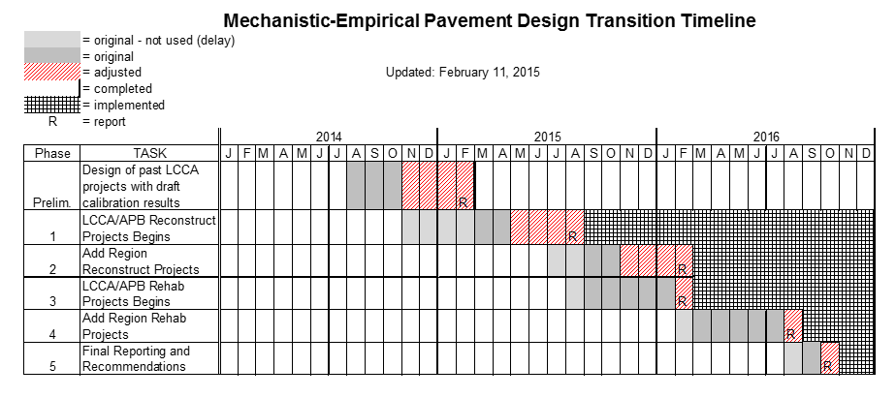
Implementation/Transition

Slide 30
Preliminary Phase Design Results

Slide 31
Preliminary Phase Design Results
The Preliminary Transition Phase involves using the calibration results on recently life-cycled reconstruct projects to see the design produced by ME
13 life-cycled reconstruct projects from 2012 - 2014 were included
  Projects from all Regions except Superior were included
  Designs include ramps if they were included in the original life-cycle
  Using inputs agreed upon by the ME Oversight Committee and Subcommittees and the final calibration coefficients
  Life-cycles were re-run with the final ME cross-section

Slide 32
Preliminary Phase Design Results
Two sets of design results:
  Disregarding typical minimum pavement thicknesses
  With minimum thickness standards and ±1” restriction
    ±1” restriction (NEW): AASHTO 1993 design used for the initial cross-section in ME. Final ME design cannot vary from this by more than 1”.

Slide 33
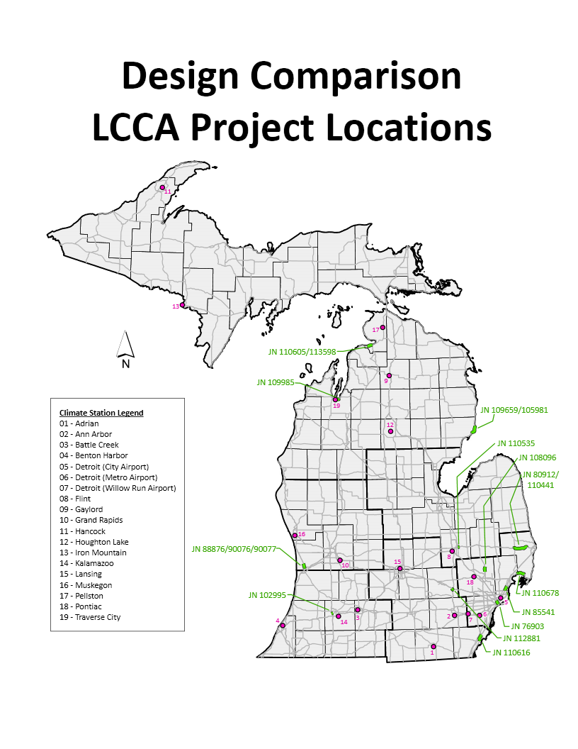
Preliminary Phase Design Results

Slide 34
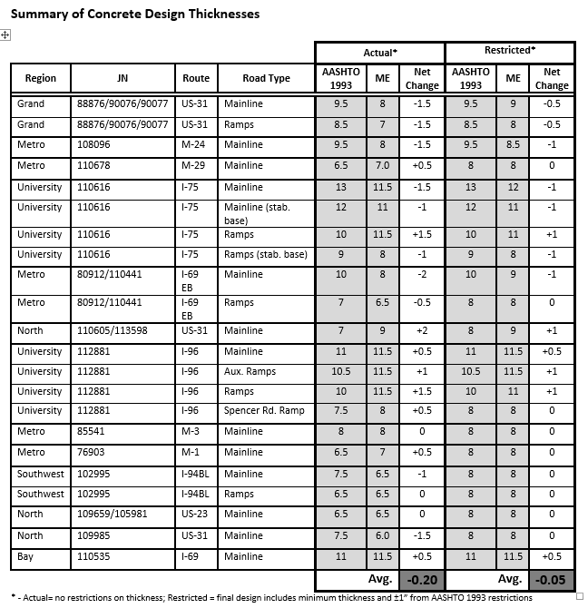
Preliminary Phase Design Results

Slide 35
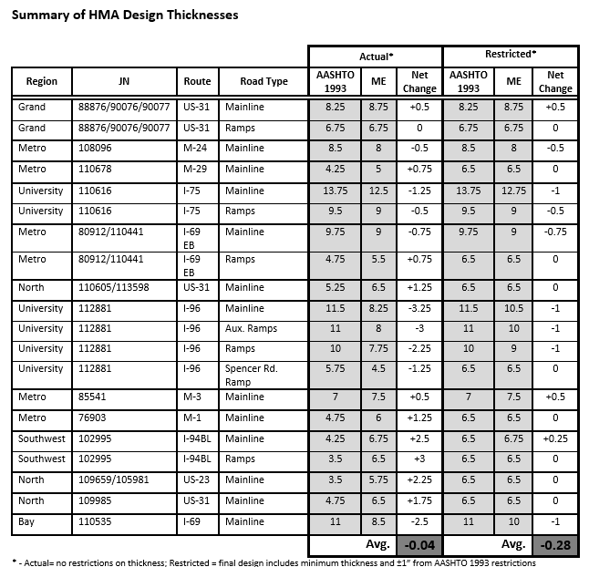
Preliminary Phase Design Results

Slide 36
Preliminary Phase Design Results
Average thickness change from original designs used in life-cycle:
  Concrete: -0.05”
  HMA: -0.28”
  Average includes the designs that did not change due to minimum pavement thicknesses
These final designs were plugged into the original life-cycles

Slide 37
Preliminary Phase Design Results
Life-cycle results:
  Results from all 13 projects were the same – original low cost alternative did not change
  Difference between the two options was closer on 5 projects
  Difference between the two options was wider on 4 projects
  Four projects did not have thickness changes (minimum thickness standards) – life-cycle not re-run

Slide 38
Preliminary Phase Design Results
Life-cycle results (cont.):
  Changes in life-cycle initial construction costs
 | 9 Re-run LCCA’s | All 13 LCCA’s | Interstate | Non-Interstate
HMA | -0.7% | -0.5% | -13.9% | +0.9%
Concrete | -2.1% | -1.5% | -1.8% | -1.9%

Slide 39
Transition Phase 1

Slide 40

Transition Phase 1
Phase 1 involves using ME for life-cycled and APB new/reconstruct projects
Normal review processes: MDOT internal, industry, EOC
Construction Field Services will be producing a detailed report on each project design: inputs used, design results, reasons for each iterative design, etc.

Slide 41
Transition Phase 1
Phase expected to go through August
Summary report on design results to be provided to EOC
  EOC approval needed to move on to next phases

Slide 42
Transition Phase 1
HMA Design Thresholds:
Performance Criteria | Limit | Reliability
Initial IRI (in./mile) | 67 | 95%
Terminal IRI (in./mile) | 172 | 95%
Top-Down Fatigue Cracking (ft/mile) | Not Used | Not Used
Bottom-Up Fatigue Cracking (percent) | 20 | 95%
Transverse Thermal Cracking (ft/mile) | 1000 | 95%
Total Rutting (in.) | 0.5 | 95%
Asphalt Rutting (in.) | Not Used | Not Used

Slide 43
Transition Phase 1
JPCP Design Thresholds:
Performance Criteria | Limit | Reliability
Initial IRI (in./mile) | 72 | 95%
Terminal IRI (in./mile) | 172 | 95%
Transverse Cracking (% slabs cracked) | 15 | 95%
Mean Joint Faulting (inches) | 0.125 | 95%

Slide 44
ME Webpage

Slide 45
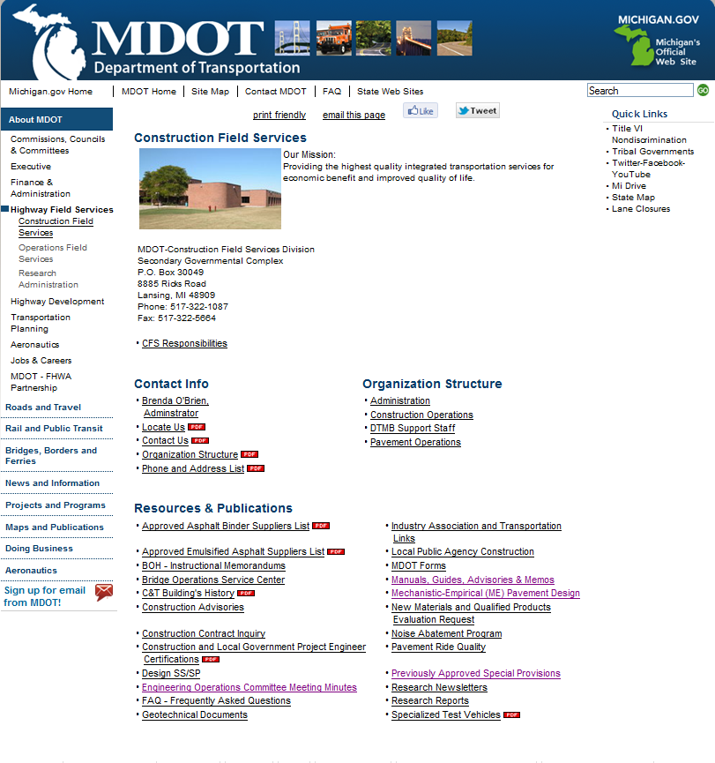
MDOT ME Webpage
Public webpage location: Link is on Construction Field Services public webpage:

Slide 46
ME Webpage
Direct Link:
www.michigan.gov/mdot/0,4616,7-151-9623_26663_27303_27336_63969---,00.html

Slide 47
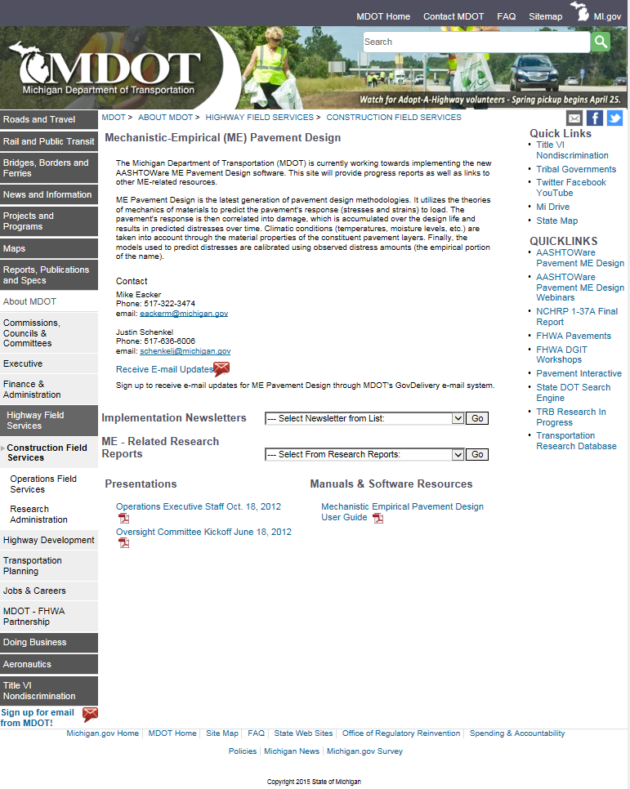
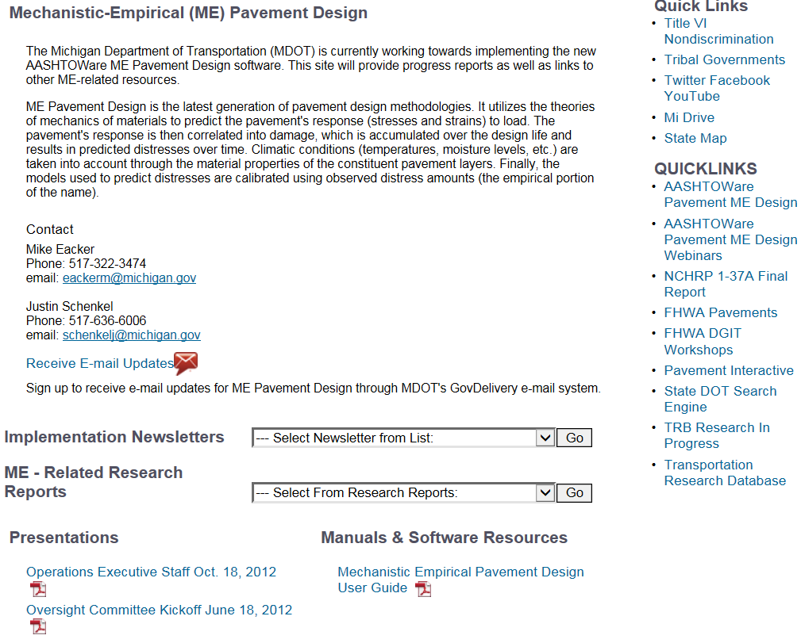
ME Webpage

Slide 48
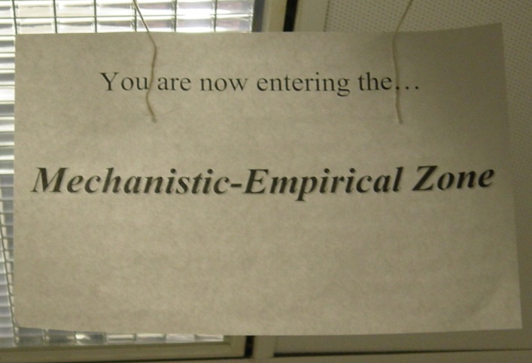
Questions?
Mike Eacker
eackerm@michigan.gov
517-322-3474
Justin Schenkel
schenkelj@michigan.gov
517-636-6006

