Slide 1

NAPA Scan Tour - Japan
APAM Spring Conference 4/21/15
Aaron Price –
Pete Capon – Rieth-Riley Construction Co.

Slide 2
Presentation Outline
Introduction-Why visit Japan?
R &D
Mix Design (High RAP)
Mix Production & RAP Management
Construction
Take-Aways

Slide 3
Broad Take-Aways
Strong Quality Focused Culture
Different Industry Structure than the US
Pro-Recycling Government Policies/Contractor Philosophy
Mixture Production Processes are different than the US
High Degree of Contractor R&D/Innovation

Slide 4
Why Visit Japan?
The National Asphalt Pavement Association (NAPA) learned that, Japan averages 45%+ RAP in their asphalt mixtures.
NAPA organized the Scan Tour with Japanese counterparts to facilitate this technology transfer

Slide 5
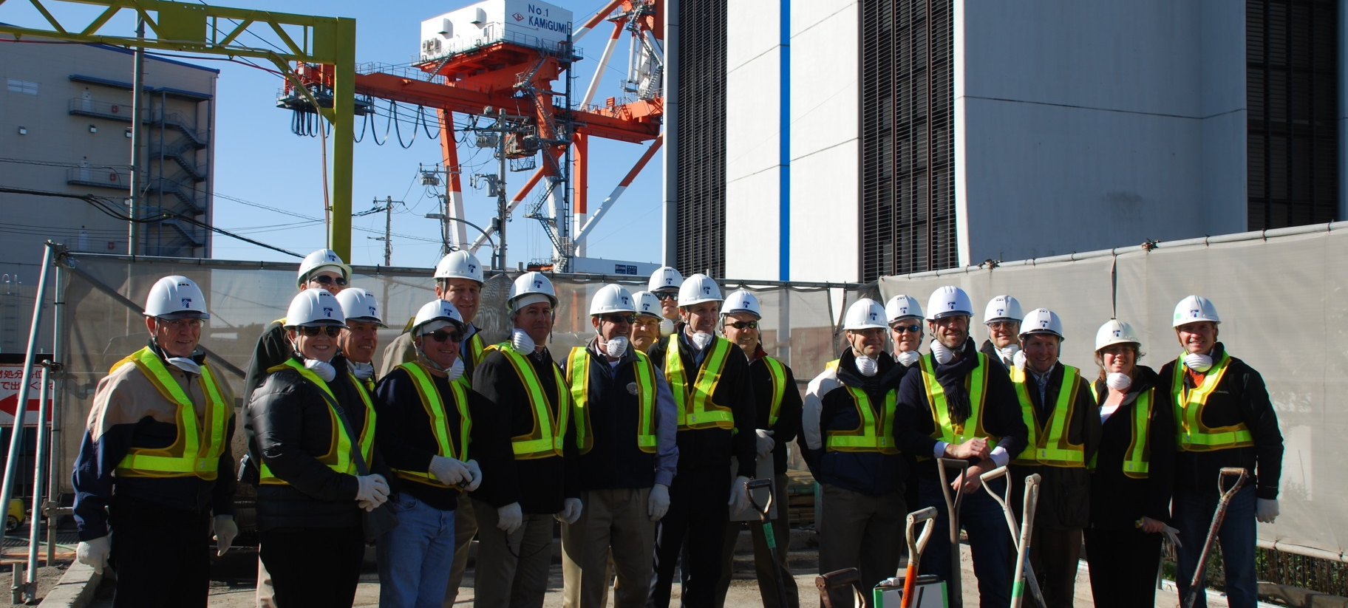
US Delegation
TaiseiTotec Plant Visit

Slide 6
Size and scale compared to U.S.
Japan has roughly half the population (126 million) and only about 4% of the land area of the U.S.
  Over 1,000 plants producing 50 million tons
Unites States production is 350 million tons with about 3,000 Plants

Slide 7
General Observations
Blend of old traditions and new technology
In some specific areas – the Japanese would appear to be more advanced than the US but in many ways are somewhat behind the US
Lower production rates (75-150 TPH typical)
5 Contractors perform most of the work
Typical projects are 2000 tons

Slide 8

Motivation - Recycling in Japan
Government mandate
  Japanese concluded in 1992 that RAP mixtures were as good as virgin mixes
Limited resources
  Virgin aggregate comes from Russia
  Oil is imported
  RAP is a valuable resource

Slide 9
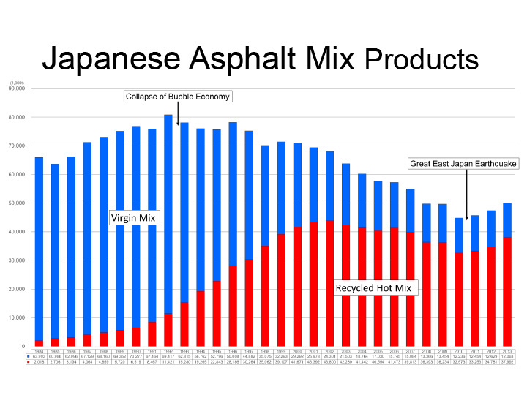
Japanese Asphalt Mix Products

Slide 10
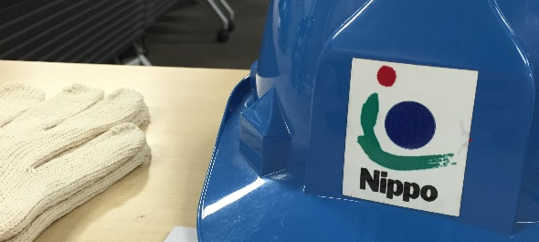
Research and Development

Slide 11
R & D Observations
Contractors have extensive research labs
High level of trust between industry and agency
Warranties – Rutting (primary focus) and Cracking
Empirical emphasis – observation based
Performance Based Specifications
Just starting to look at WMA technologies
High RAP Mixtures (with and w/o foamed rejuvenators)

Slide 12
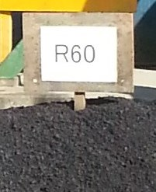
Innovation – High RAP
Up to 70 % RAP
Use of Rejuvenators
RAP materials made into an HMA-like mix
Silo time for RAP matl.
High RAP Mixtures are a Manufacturing Process

Slide 13
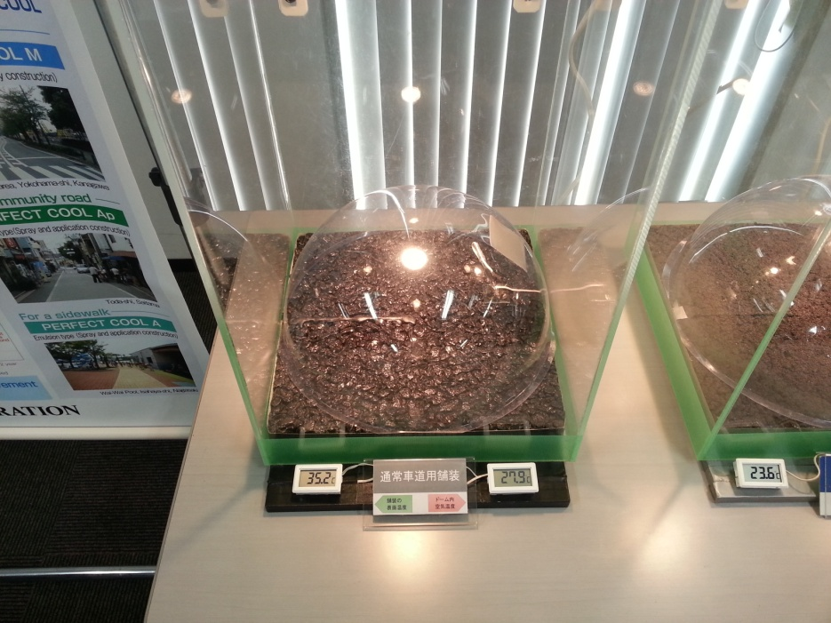
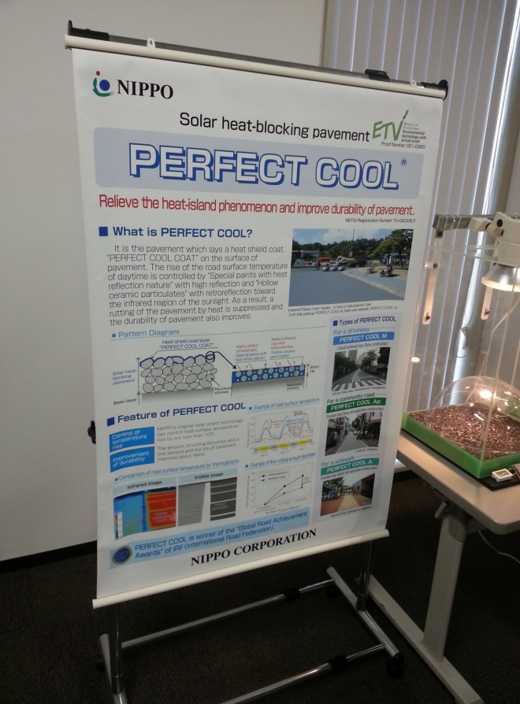
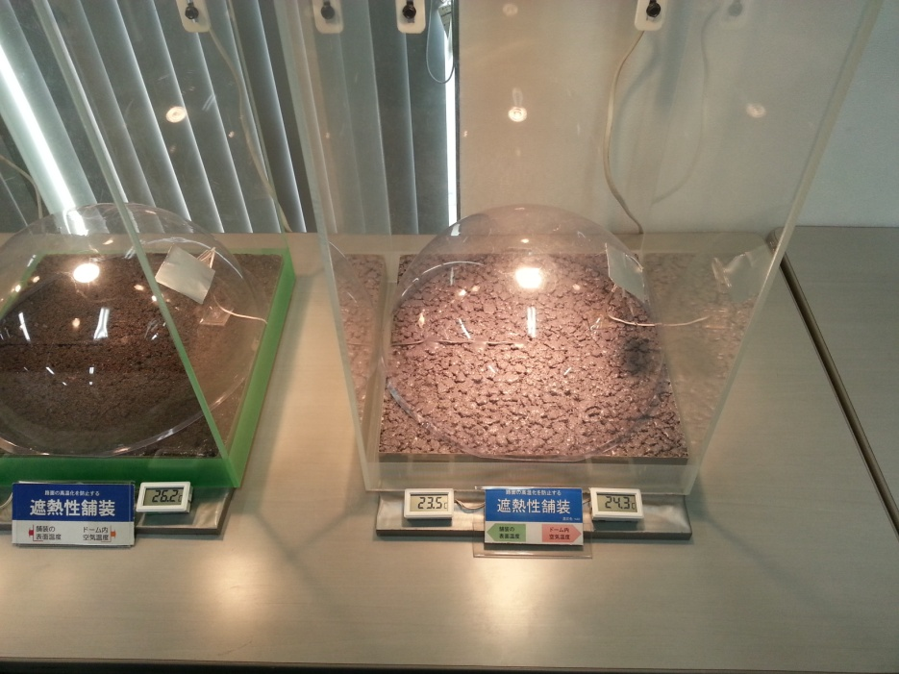
Innovation–Pavement Color/Temp

Slide 14
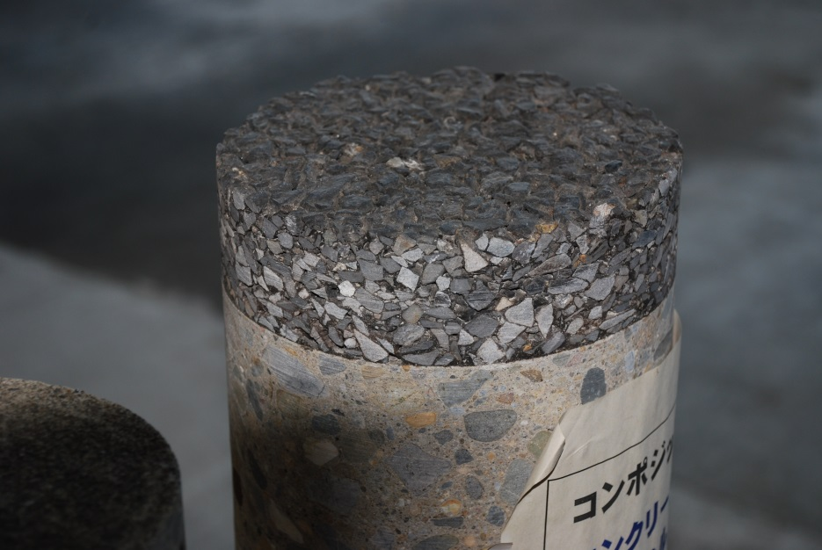
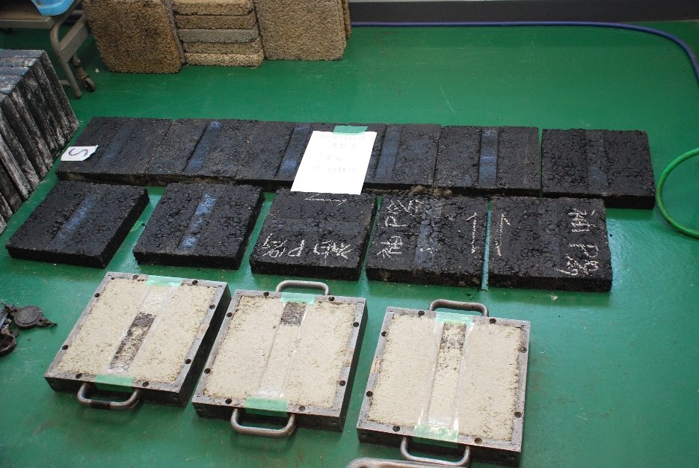
Innovation
OGFC
Rutting/Wheel
Tracking Tests

Slide 15
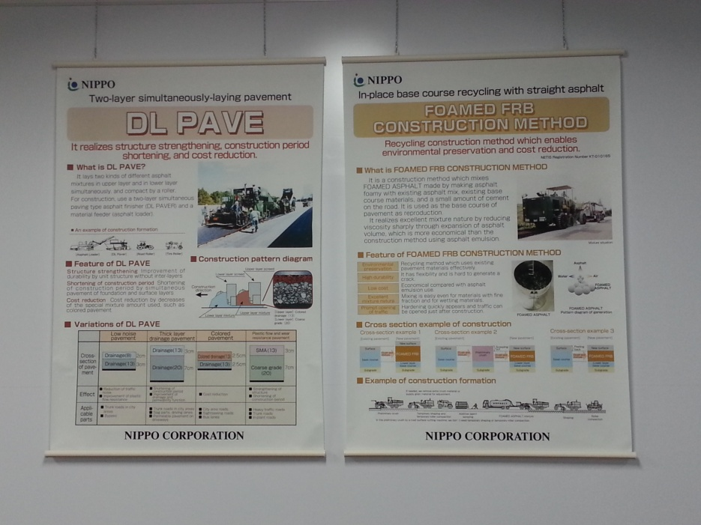
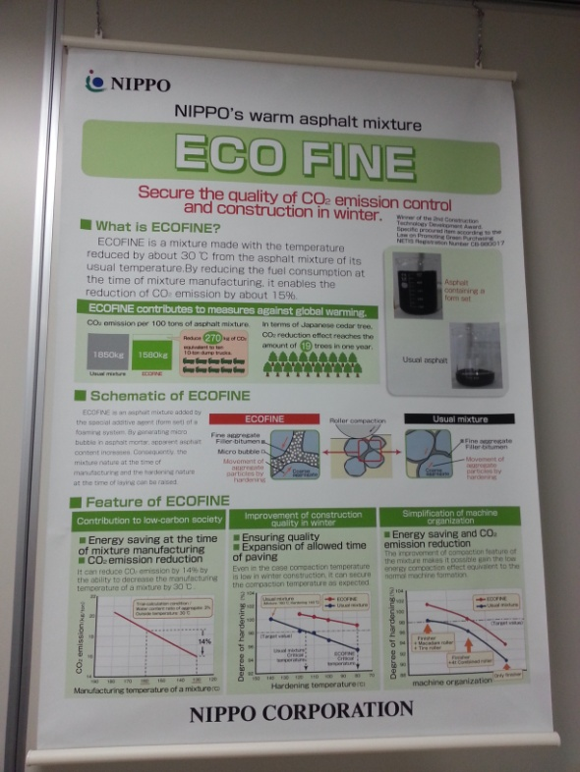
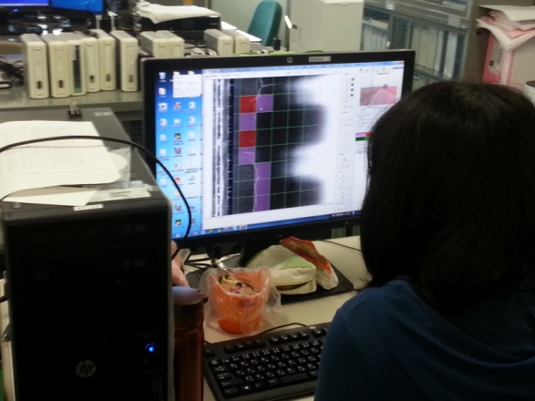
Innovation
Pavement
Management
Dual Layer Paving
WMA

Slide 16
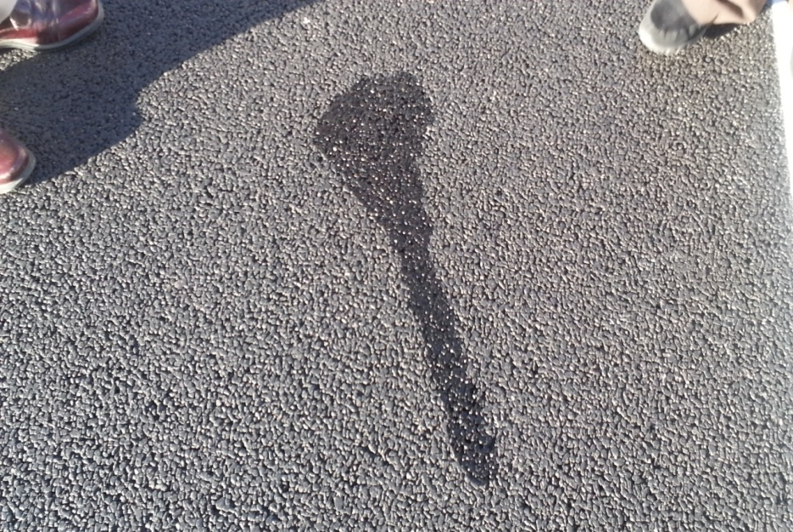
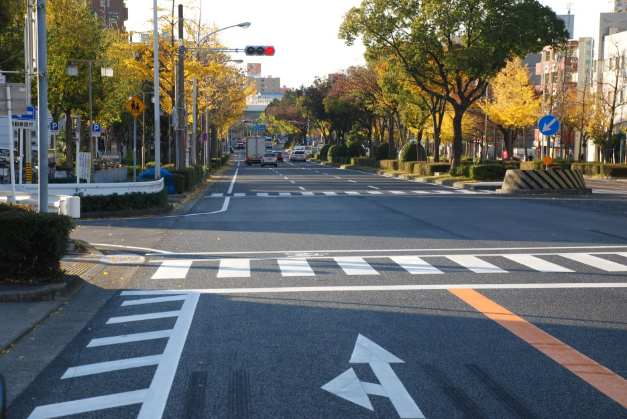
Innovation - Double Layer Porous

Slide 17
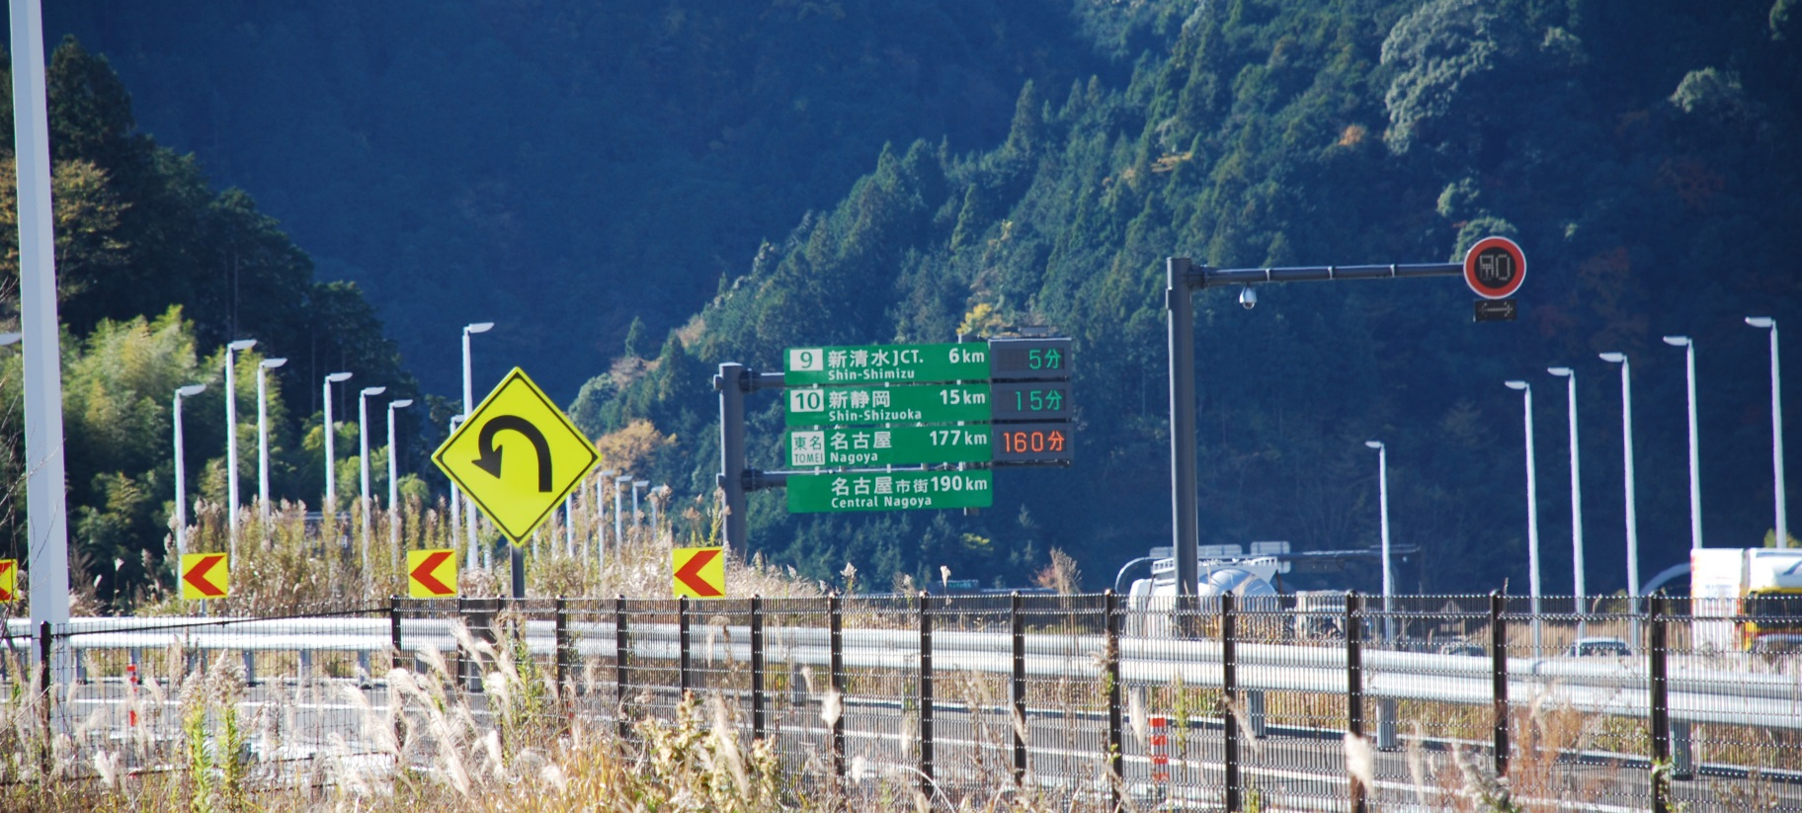
High RAP Mix Design
Asphalt Paving Project

Slide 18
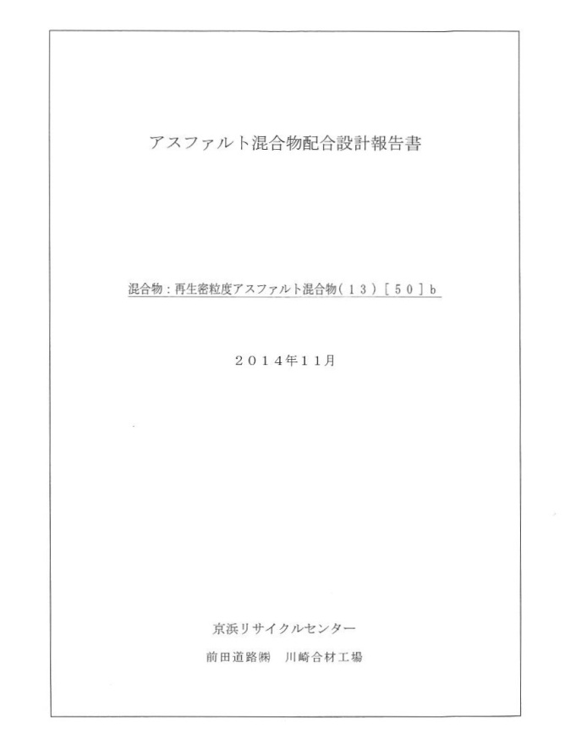
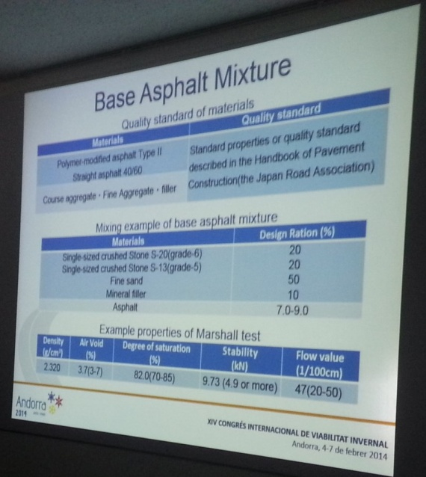
Mix Design
Marshall Mix Design
Pen/Viscosity Grade Binders
Polymers are utilized
Mix Designs appear to be “richer” than non-regressed SP mixes
Performance tests

Slide 19
Mix Design – Randy West (NCAT)
Japan has established simple mix tests to evaluate mix designs
  Those tests are the indirect tensile modulus (peak stress/deformation) and a wheel tracking test (dynamic stability)
This allows the mix designer (contractor) to be innovative in developing combinations of materials (e.g. RAP, softer virgin binders, and rejuvenators) to meet the mix design criteria (blending charts).

Slide 20
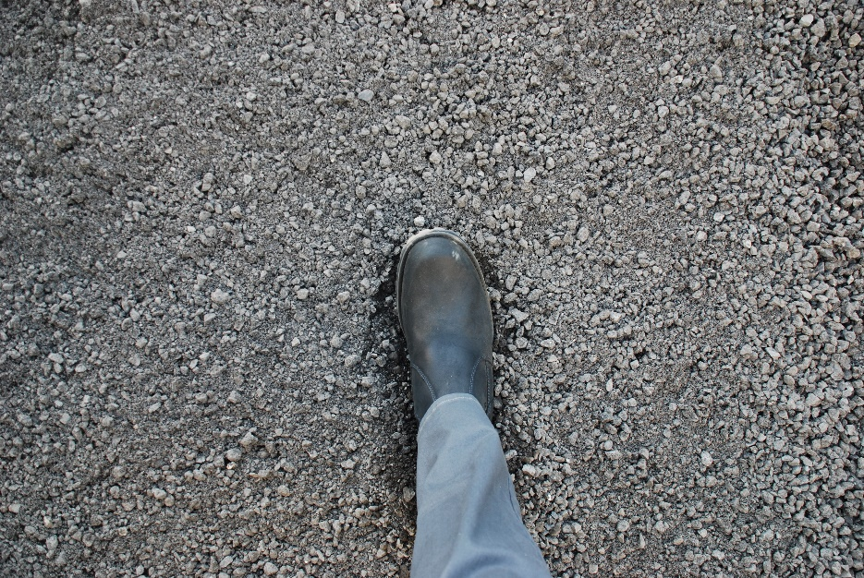
RAP Parameters
RAP binder must have a 20+ penetration and 3.8%+ AC or it can/will be discarded
Fractionated into 2 or 3 sizes to develop proper blend

Slide 21
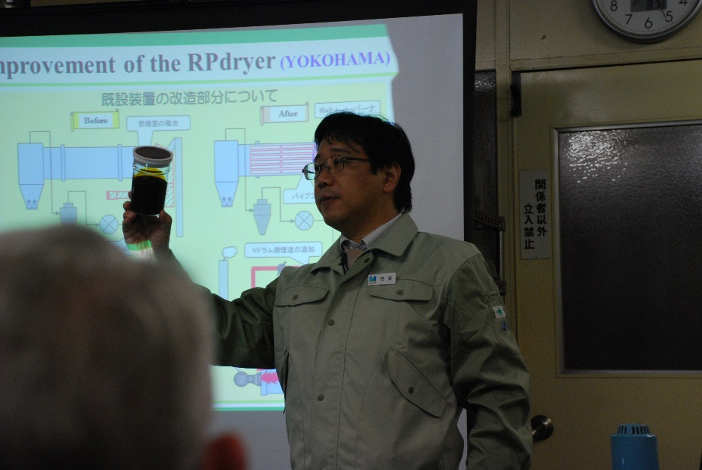
Rejuvenators
The key to using high RAP mixtures is the introduction of a rejuvenating agent to condition the RAP
It softens and activates the hardened – it takes time, 1-3 hours in the silo after mixing

Slide 22
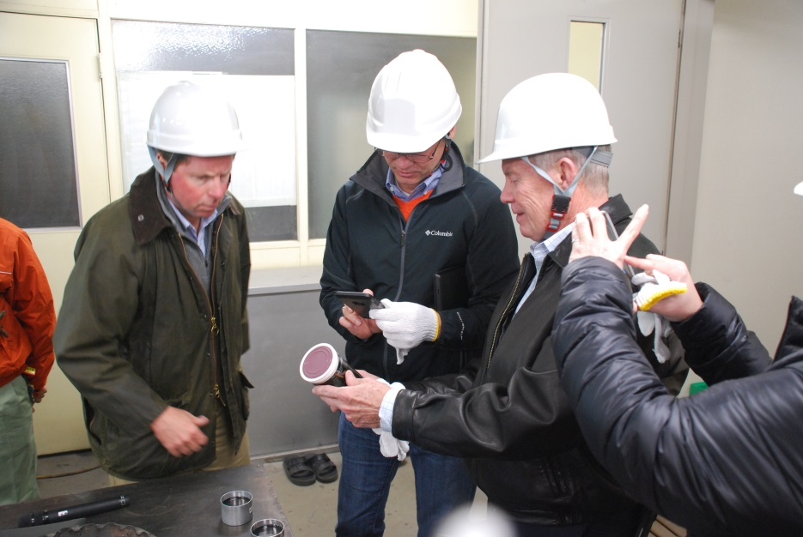
Rejuvenators
Proprietary!
One identified as paraffinic oil
Many options

Slide 23
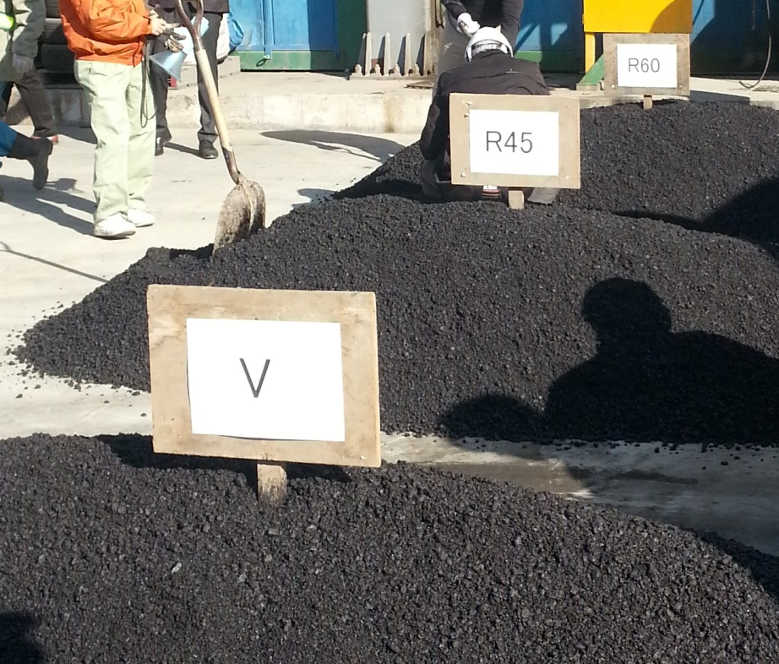
Mix Types
They keep mix types to a minimum and simple descriptions
High RAP Examples: Batched a virgin mix along with 45% and 60% RAP mixtures

Slide 24
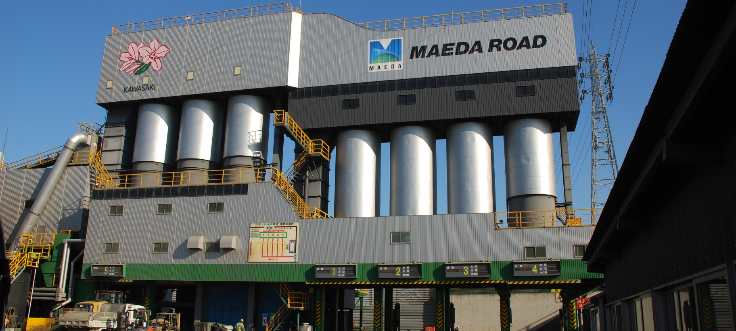
High RAP Mixture Production
Asphalt Plant in Japan

Slide 25
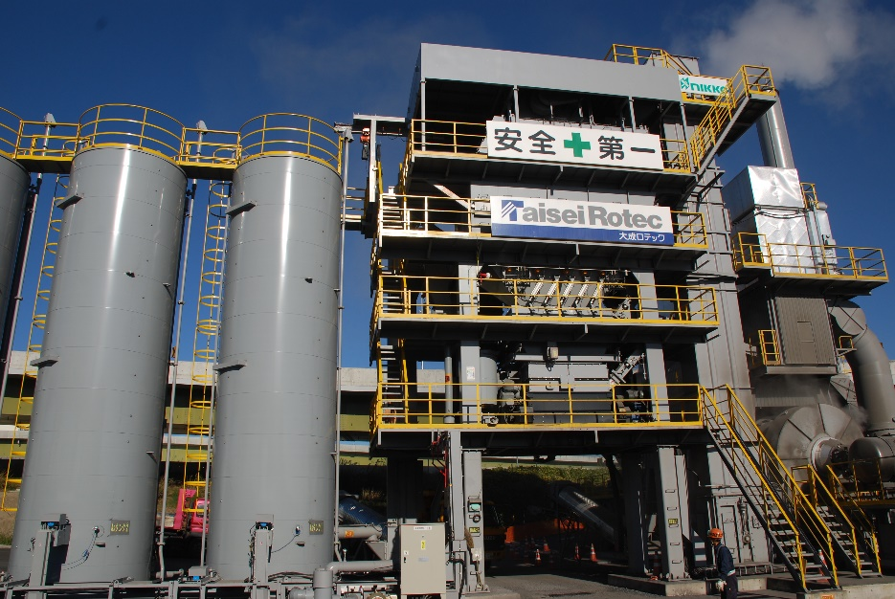
Recycling Methods in Asphalt Plants

Slide 26
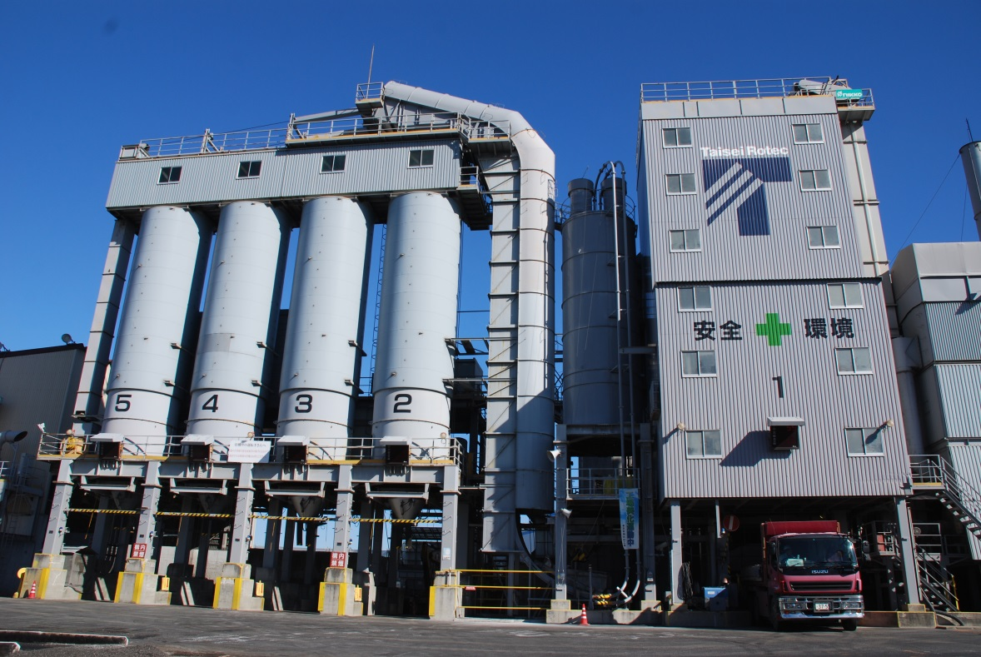

Maeda Road & TaiseiRotec Plants
Parallel Heat System
Batch plant producing 180 tons/hour
  270,000 tons/year
32 employees with dorm so that mix available 24 hours
Dust and Odors are tightly controlled

Slide 27
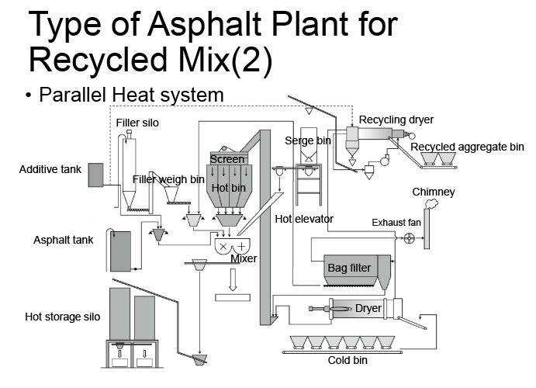
Parallel Heat System – Two Dryer
Most common plant type (68.8%) and the type we visited while on our tour
Parallel dryers… Parallel for recycle and Counter-Flow for virgin materials
Notes:
The first slide is describing a plant process where the RAP is heated in a parallel flow dryer, and the virgin aggregate is heated in a counter flow dryer. I am not sure if the term “parallel heat system” means that they use two dryers or if it means the RAP is heated with a parallel flow dryer. I suspect it is the latter.

Slide 28
Material Flow
RAP is heated (300º-320º F) in the dryer/mixer (Parallel flow, indirect heating)
Rejuvenator added to RAP in dryer/mixer or pugmill, then transferred to surge bin/silo (1-3 hours hold time)
Virgin materials dried and moved over screens (typical)
RAP mixture is mixed with virgin aggregates and AC in the mixer

Slide 29
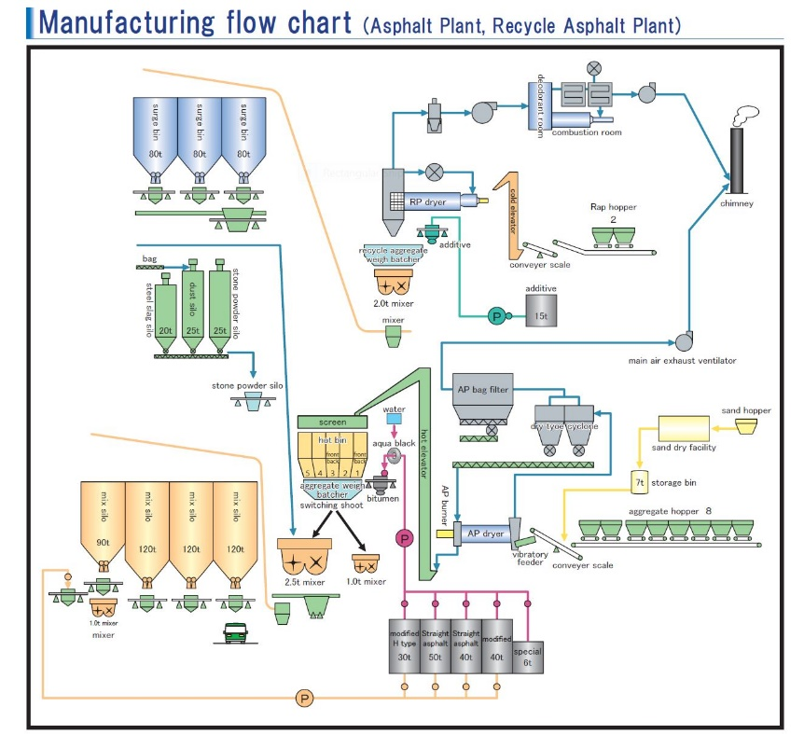

Slide 30
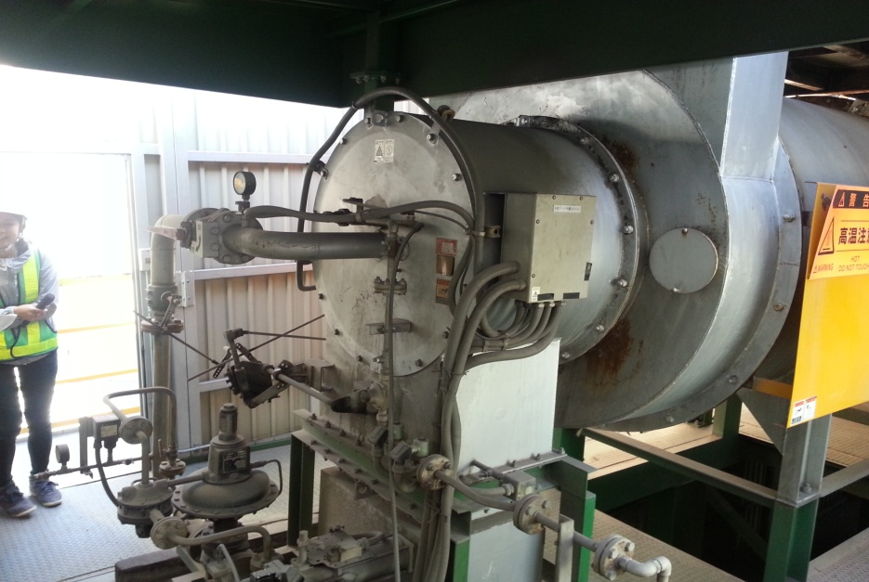
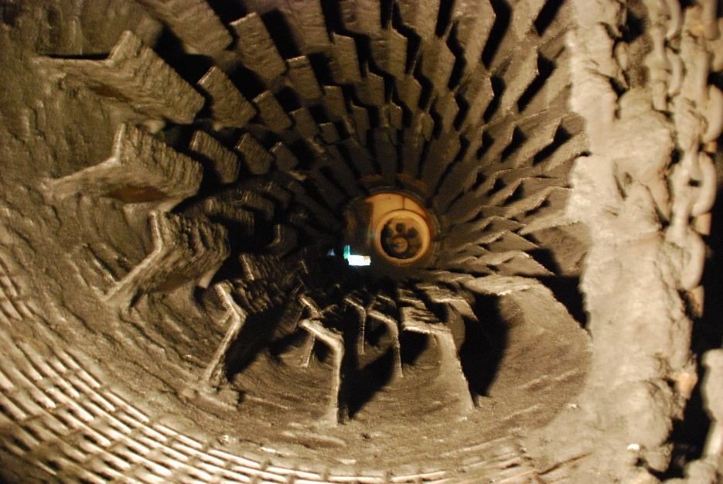
RAP Dryer/Mixing Drum

Slide 31
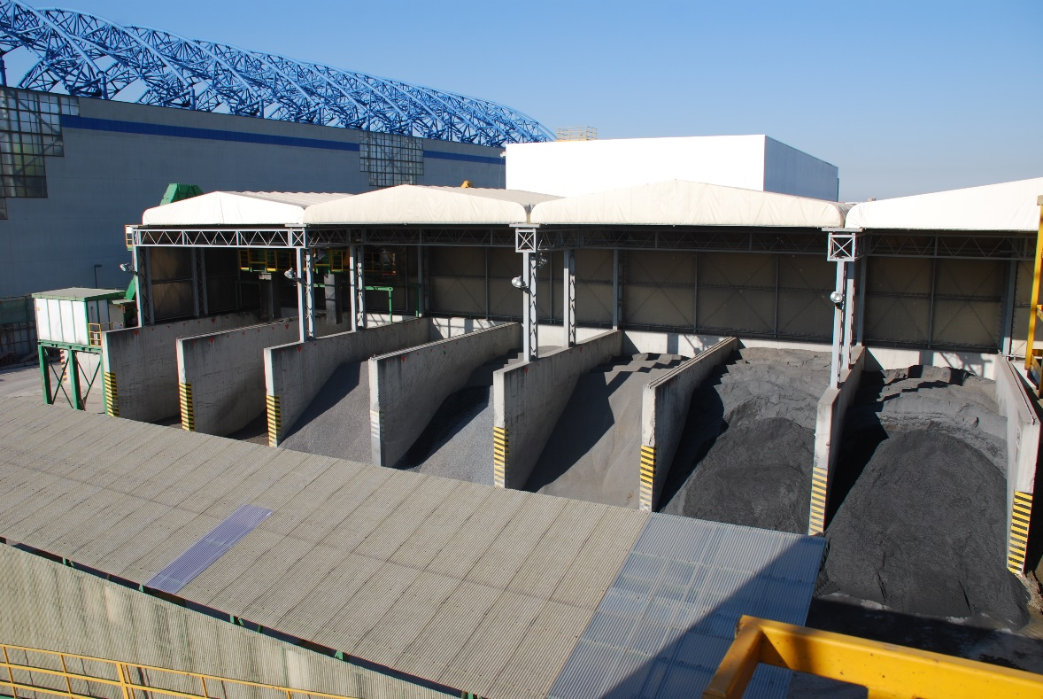
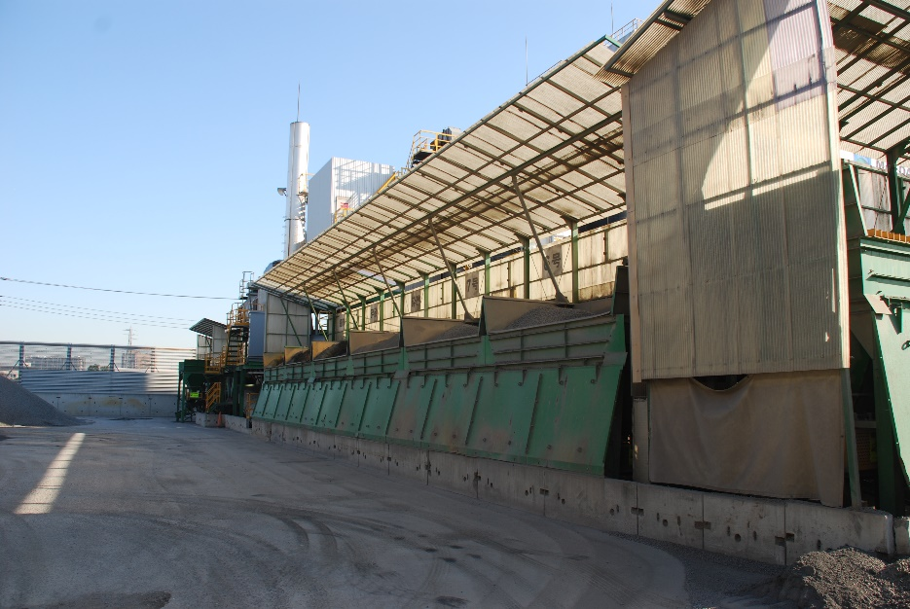
Virgin Matls. - Clean and Covered
Handled and processed similar to the United States
Covered cold feed bins to maintain low moisture content
Binders can be blended in-line if needed

Slide 32
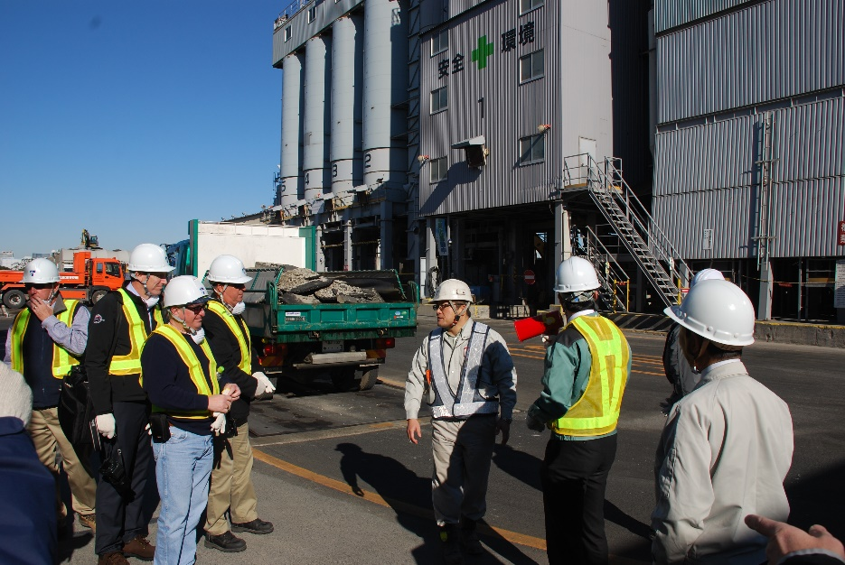
Processing RAP
Most of the RAP we observed was delivered in pieces (milling/cutting is performed but not as common as in the US)
Delivered to the asphalt plant for processing
Crushed, sized & screened

Slide 33
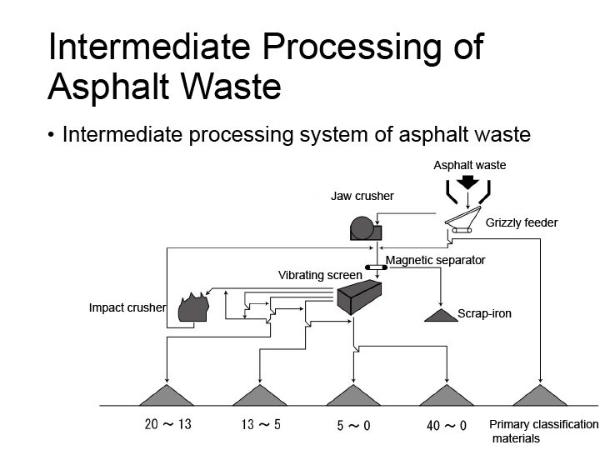
Processing RAP - Cont.
RAP is fractionated much like it is here in the U.S.
The RAP processing facility we visited was indoors (strict dust and pollution requirements)

Slide 34
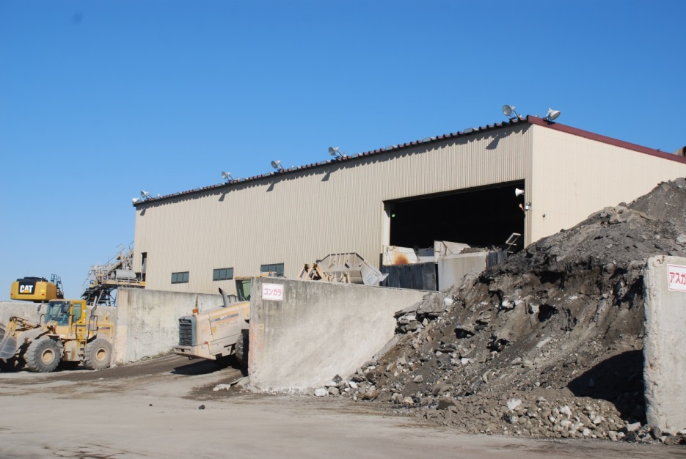
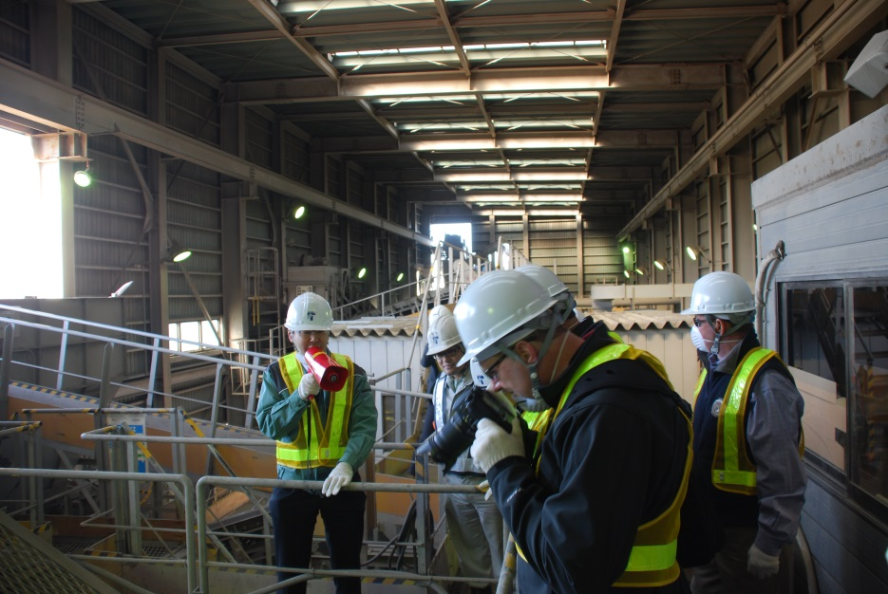
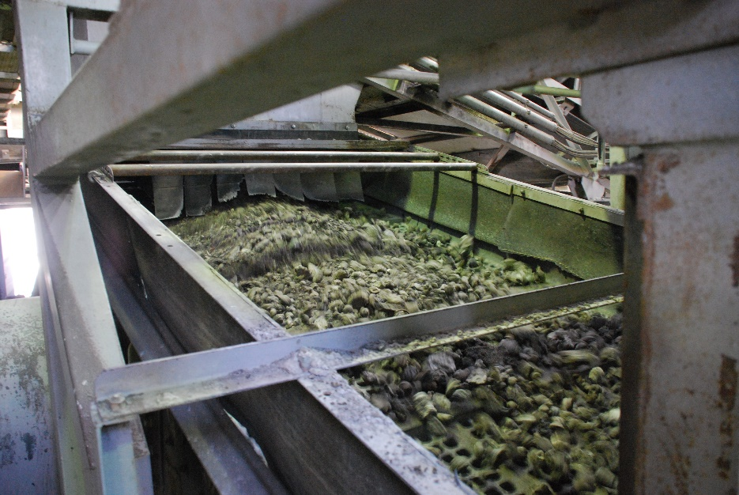
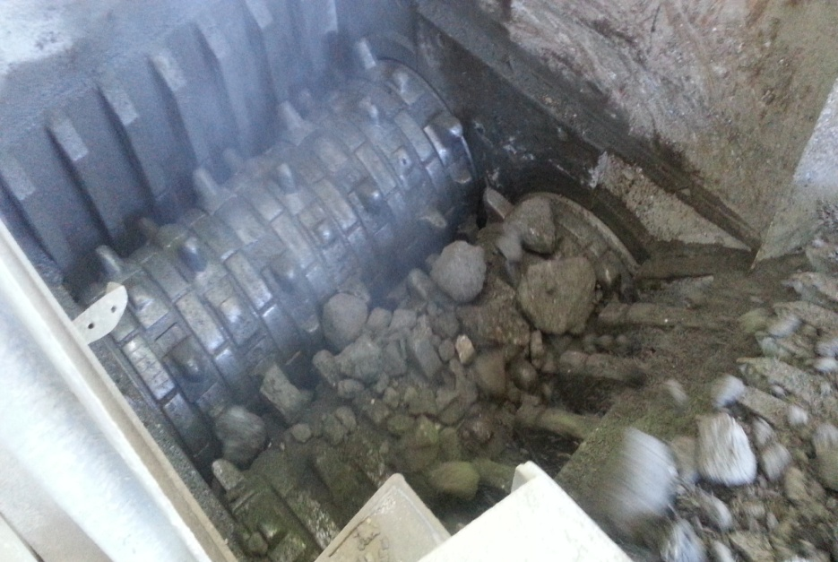
RAP Indoor Processing Facility

Slide 35
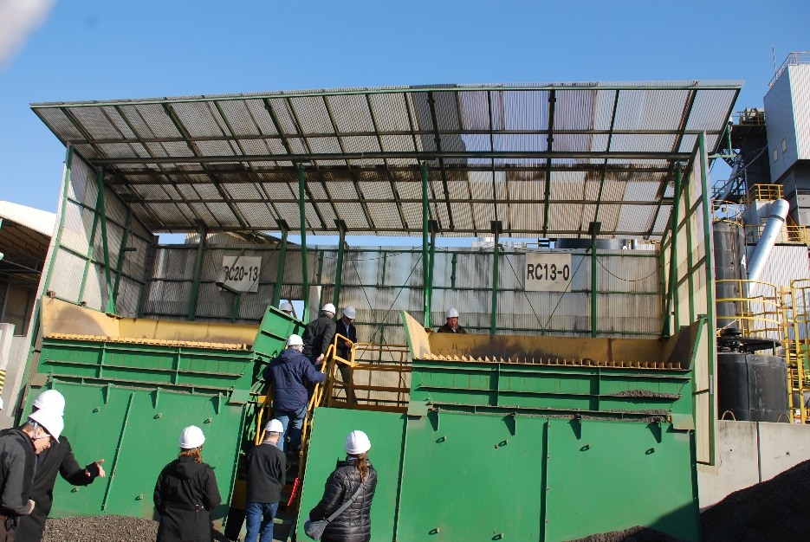
Managing RAP Materials
Covered processing and bin storage
  They keep RAP dry… reported at 1.5%-2.0% moisture
RAP is tested for gradation, binder % & penetration grade

Slide 36
Construction
Asphalt Paving Project

Slide 37
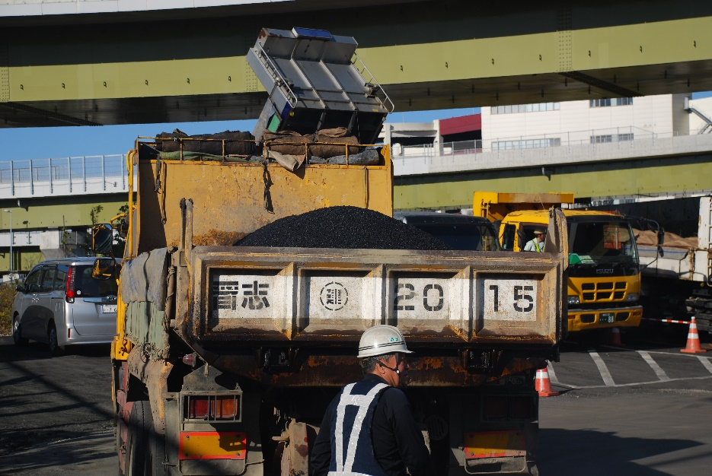
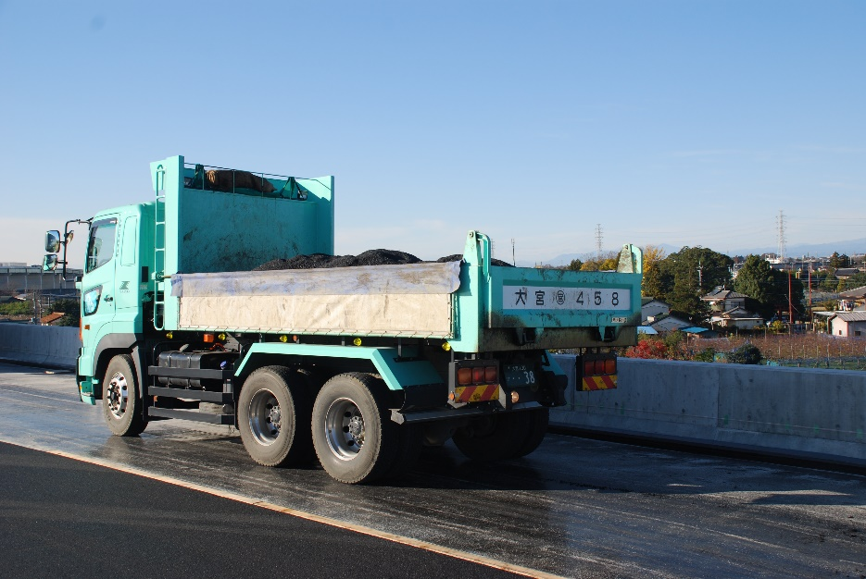
Trucking Operations

Slide 38
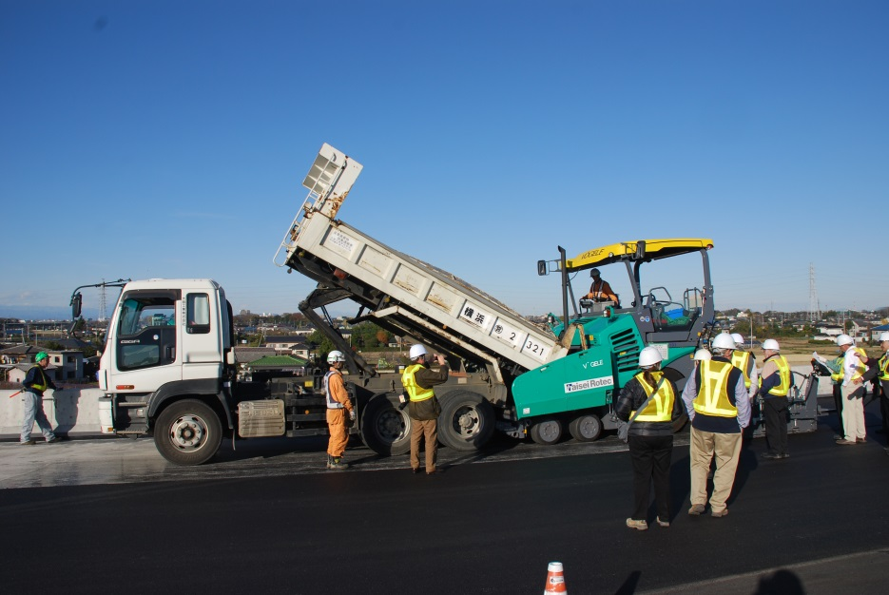
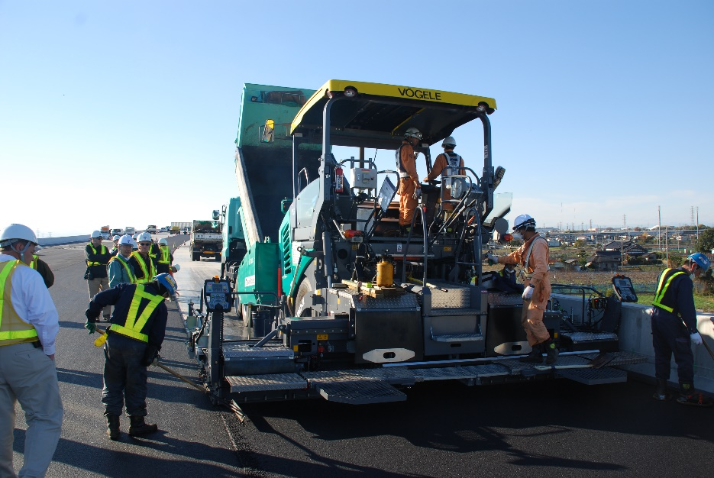
Paving Operations

Slide 39
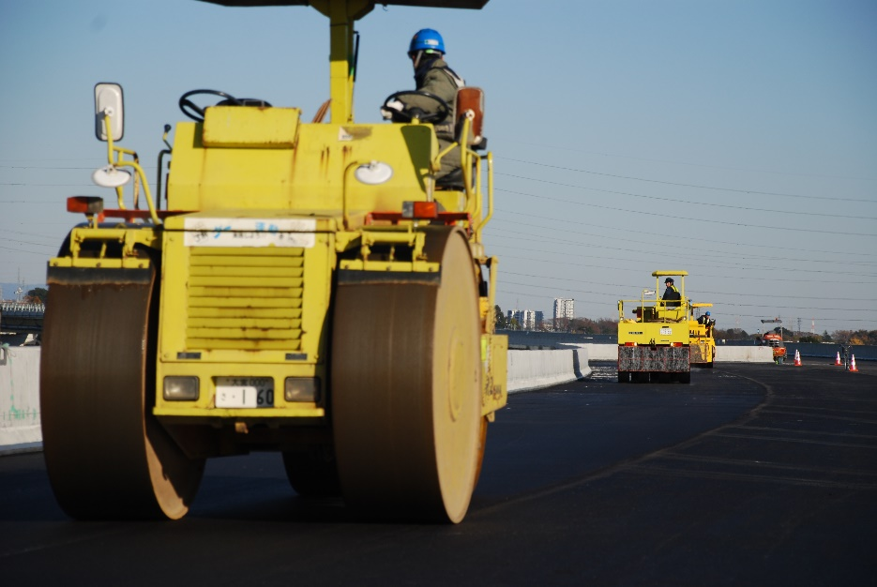
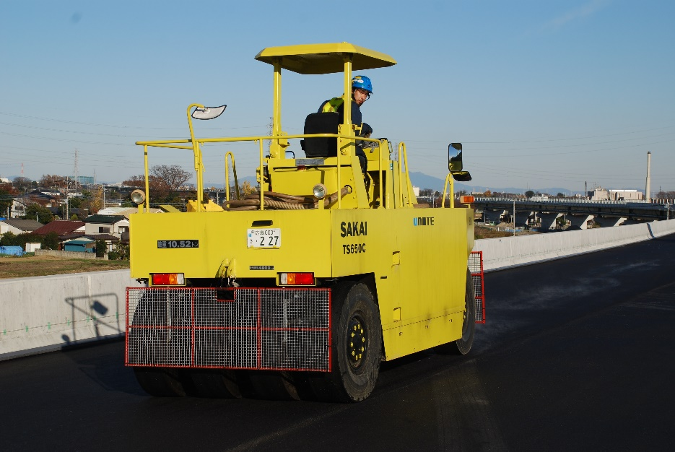
Compaction

Slide 40
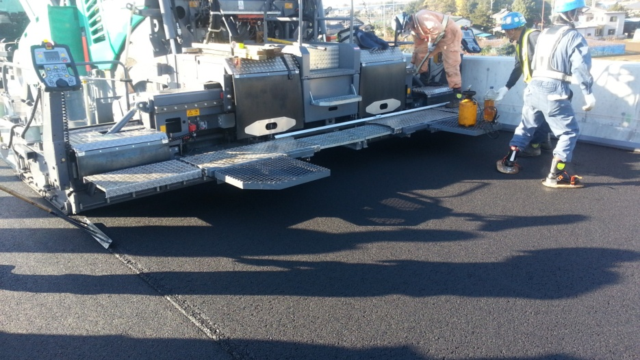
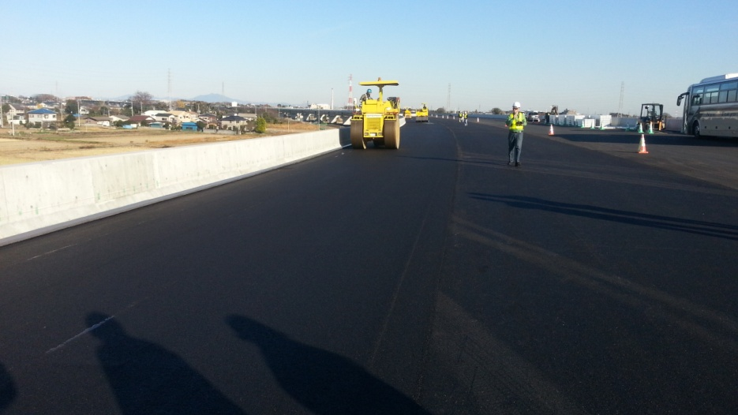
Excellent workmanship

Slide 41
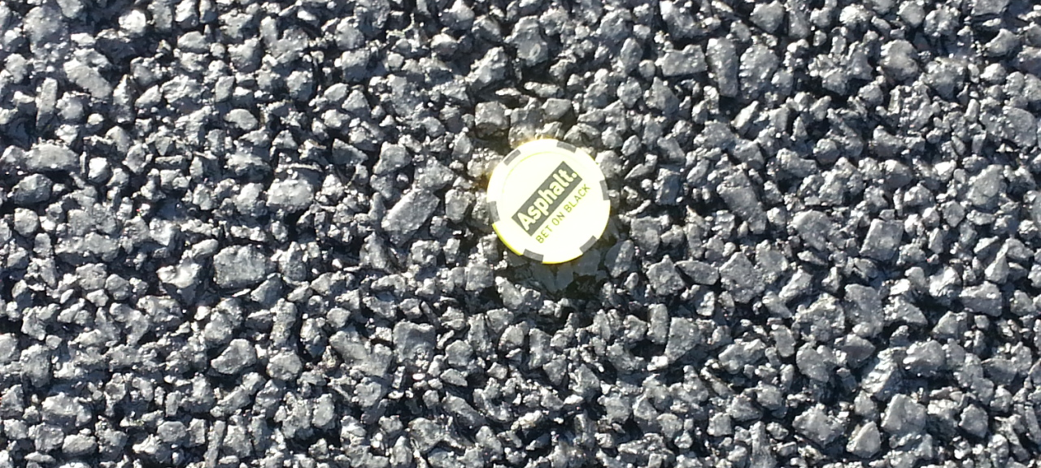
Takeaways

Slide 42
Broad Take-Aways
Strong Quality Focused Culture
Different Industry Structure than the US
Pro-Recycling Government Policies/Contractor Philosophy
Mixture Production Processes are different than the US
High Degree of Contractor R&D/Innovation

Slide 43

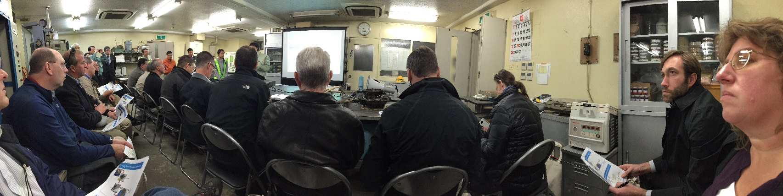
Take-Aways – Specifics
A Few Contractors perform much of the work
to High RAP mixes - indirectly dried/heated (320º F) & mixed w/rejuvenators (RAP mix silo time 1-3 hrs) - the process could work in the US in the future
RAP Mix (rejuvenators) + Virgin Matls. = High RAP
RAP is highly managed (many times processed indoors, fractionated, stored in bunkers, etc.)
Mix production is a manufacturing process
RAP mixes can perform as well as virgin mixes
High level of trust between industry and agency
Warranties – Rutting (primary focus) and Cracking
Empirical emphasis – Observation based, if it works don’t fix it

Slide 44

Questions?
Aaron Pricel Cadillac Asphalt l aprice@cadillacasphalt.com
Pete Capon l Rieth-Riley Construction Co., Inc. l pcapon@rieth-riley.com

