Slide 1
2015 Local Roads Workshop Gaylord March 12, 2015

Slide 2
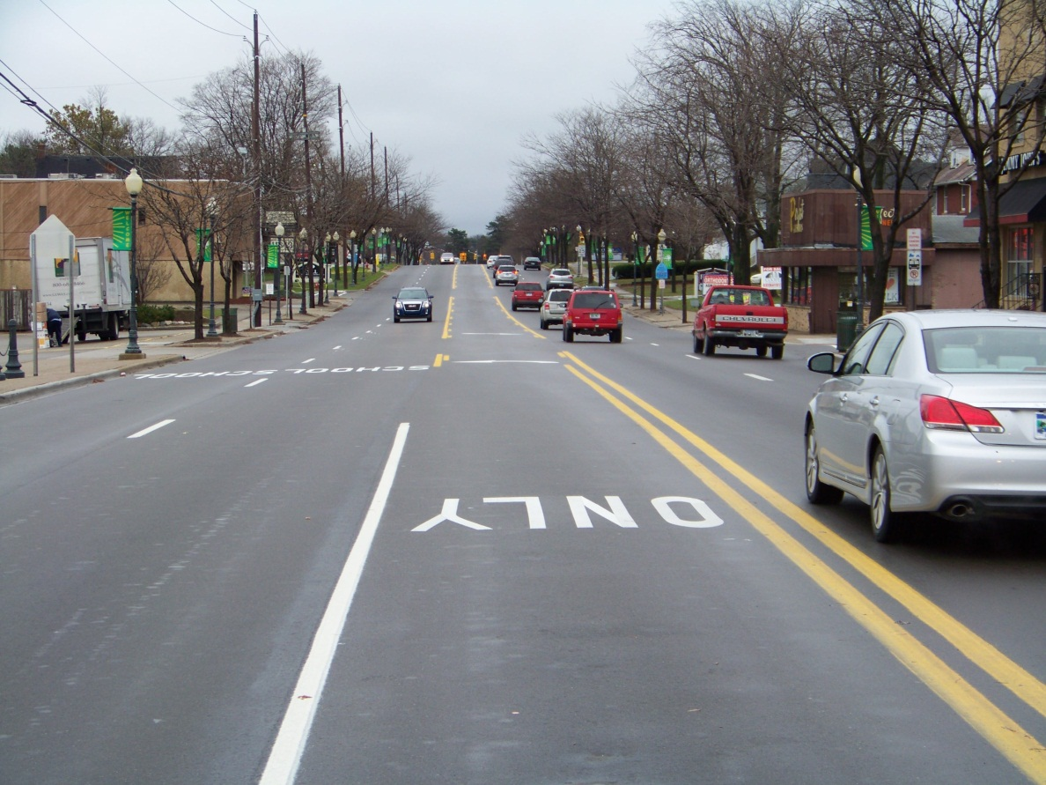
Project Scoping

Slide 3
Presentation Outline
Decision Making Process
Mix Selection
Rehab of Concrete Pavements
Preventive Maintenance

Slide 4
Decision Making Process
Pavement Management

Slide 5
Decision Making Process
Purpose of PMS
Determine current pavement condition
Predict future pavement condition with and without work
Determine where, when and what work to do
Get organized by knowing your pavement inventory
Justify budget needs
Determine what works and what doesn’t (e.g., feedback loop)

Slide 6
Decision Making Process
PMS Process
Pavement
Data
Collection
Select
feasible
alternatives
Reconstruction
Rehabilitation
Resurfacing
Project
evaluation
Monitor
Performance
Life - cycle
costs
Detailed
PS & E
Select
preferred
alternatives
Non-
monetary
factors
Construction

Slide 7
Decision Making Process
Asset Management Strategy
EXCELLENT
MAY COST $1.00 FOR
RENOVATION HERE
GOOD
40% DROP
IN QUALITY
FAIR
MAY COST
$4.00 TO $5.00
HERE
75% OF LIFE
POOR
40% DROP
IN QUALITY
VERY POOR
12% OF
LIFE
FAILED
TIME

Slide 8
Decision Making Process
Components of PMS
Pavement Inventory
Inspection
Condition Assessment based on inspection results (e.g., PASER rating, PCI, RSL, etc.)
Prediction Modeling technology for developing deterioration trends
Network Condition Analysis
Annual and long Range Work Planning

Slide 9
Decision Making Process
Network Inventory
Type of Data to be Collected
Physical characteristics
Construction and maintenance history
Traffic levels
Climate information
Soils information

Slide 10
Decision Making Process
Condition Assessment
The assessment of current condition MUST be objective and repeatable
BUT, it must also match available resources
All system recommendations are based on the current and predicted conditions of the sections in your network

Slide 11
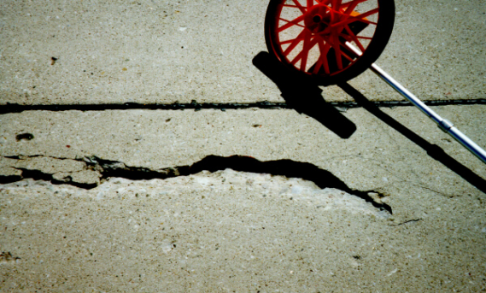
Approaches to Collecting Pavement Condition Data
Decision Making Process
Manual
Semi-automated
Automated

Slide 12
Decision Making Process
PASER – Pavement Surface Evaluation and Rating System
Rating Scale 1 - 10
Rating of 1 represents a condition needing total replacement.
Rating of 10 represents the best, or new construction.
Surface Condition
Important to public
Simplified PMS system

Slide 13
Presentation Outline
Decision Making Process
Mix Selection
Rehab of Concrete Pavements
Preventive Maintenance

Slide 14
Mix Selection – Mix of Fixes
Capital Preventive Maintenance - (Crack Filling, Surface treatments, thin overlays)
Rehabilitation - Conventional overlays, Rubblization, ASCRL, Etc.
Reconstruction - Full depth pavement removal and replacement (10 – 13 inches)
Notes:
We support the concept of using a “mix of fixes” approach to pavement management:
Preventive maintenance - (Crack Filling, Surface treatments, thin overlays)
Rehabilitation - Conventional overlays (3 to 6.5 inches, usually with base preparation)
Reconstruction - Full depth pavement removal and replacement (10 – 13 inches)
This Provides a system for pavement owners to select an optimal combination of fixes to achieve system condition goals at the lowest total cost.
It is important to acknowledge that pavements do eventually wear out. We are going to have to reconstruct and rehabilitate some of the roads – we can’t just rely on preventive maintenance to achieve sustainable pavement conditions.

Slide 15
Mix of Fixes
Capital Preventive maintenance: Shorter Term Fixes
1 ½” HMA Overlay
Milling and 1 ½” HMA Overlay
Crack Treatment
Overband Crack Filling
Chip Seal
Micro-Surfacing
Ultra-Thin HMA Overlay

Slide 16
Mix of Fixes
Rehabilitation: Medium Term Fixes
Structural HMA Overlay (Multiple Course)
Mill and Structural HMA Overlay
In-Place Recycling
Crush and Shape
Cold-in-Place
Hot-in-Place
Full Depth Reclamation
Rubblization
ASCRL

Slide 17
Mix of Fixes
Reconstruction: Long Term Fixes
Full depth pavement removal and replacement (10 – 13 inches)
New Construction

Slide 18
Selecting the Right Mix
Selection of Mix for:
Optimum Performance
Economics
Binder Selection Economics
Lift Thickness vs. Performance
Use of RAP
Notes:
Minimum lift thickness is not always good!

Slide 19
Binder Selection
Example:
1 ½” resurfacing of existing road
98% reliability binder grade is PG 64-28
Consider using PG 64-22 ?
Reflective cracking
Notes:
Good example - especially if a shorter term fix ( 7-9 yrs)
Or 58-34, consider using 58-28

Slide 20
Lift Thickness based on Nominal Maximum Aggregate Size (NMAS)
NMAS – 1 size larger than the first sieve to retain more than 10%

Slide 21
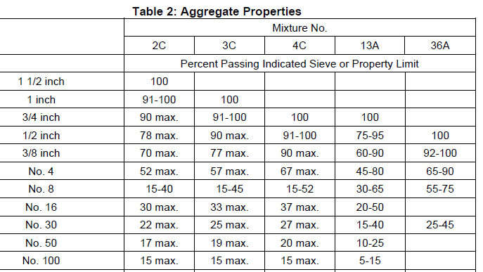
NMAS
Ex: 4C mix – NMAS is ½”
Notes:
Example, 4C mix – NMAS is ½ inch

Slide 22
Local Agency Programs HMA Selection Guidelines
Mixture Type | Marshall Mixture |  |  |  |  | Superpave Mixture
 | 36A | 13A | 2C | 3C | 4C | 3E_ | 4E_ | 5E_
Min. #/syd | 110 | 165 | 350 | 220 | 165 | 330 | 220 | 165
Max. #/syd | 165 | 275 | 500 | 330 | 275 | 410 | 275 | 220
Note: Application Rate of 110#/syd. Per 1 inch Thickness
Notes:
HMA Mixture Type Application Rates
Lift thicknesses based on NMAS (nominal Max Aggregate size)
For Marshall mixes: Min LT, generally 3X NMAS, Max LT, generally 5X NMAS
For Superpave mixes: Min LT, 4X NMAS, Max LT, 5X NMAS

Slide 23
Lift Thickness vs. Performance
In-place Density is Critical
Initial In-place Air Voids <8%
Lift Thickness Affects Compaction
Consolidation “Room”
Cooling Rate
Notes:
Place mixes at least at the minimum lift thickness recommended
Initial In-place Air Voids <8% non permeable
Consolidation “Room” - aggregate particles have squeeze all together
Cooling Rate - thin lifts cool quicker

Slide 24
Why Recycle RAP into HMA?
Best and Highest use
Same or better performance as virgin mix
Reduces demand for new materials
Reduces carbon footprint
Contains valuable materials
Save $
Notes:
It is estimated that recycling of asphalt pavements saves the American taxpayer $1.8 billion per year. It also saves hundreds of acres of landfill space each year.
Reclaimed asphalt pavement (RAP) can be recycled into pavement that is as high, or even higher, in quality as pavements made of all-virgin materials. And, the same material can be recycled again and again; it never loses its value. The asphalt cement—the glue that holds the pavement
together—retains its ability to function as glue or cement, so that it is reused for its original purpose. The aggregates in the original pavement
are also conserved.
HMA pavements are 100% recyclable, when you invest in HMA pavements, by using RAP you can get a return on your original investment by re-using the liquid AC and aggregates. In contrast, when using PCC, the cement represents a cost, it can not be re-used.
Taking advantage of these valuable materials can help stretch your pavement budget and get roads improved .
24

Slide 25
Why Recycle RAP into HMA?
RAP contains valuable materials :
Aggregate ~ 94% @ $10/ton
Asphalt ~ 6% @ $585/ton
Value = $44.50 /ton (minus processing)
Notes:
The $ 44 / ton in place value of the materials is probably more than the original price of the mix laid in place !
Like $ in the bank . ( return on investment )
25

Slide 26
Economics Savings Example
Aggregate: $10.00/ton
Asphalt: $585.00/ton
RAP: $9.00
Mix Design AC Content: 6.0%
Material | 0% RAP | 17% RAP | 27% RAP
Aggregate | $9.40 | $7.70 | $6.70
Asphalt | $35.10 | $29.13 | $25.62
RAP |  | $1.53 | $2.43
Total | $44.50 | $38.36 | $34.75
$ Savings |  | $6.14 | $9.75
% Savings |  | 13.8% | 21.9%
Notes:
One last example
??????

Slide 27
Recommended Practices for Use of RAP (and RAS)
Follow best practices for the processing and management of RAP
Contractor to sample and test RAP during processing
RAP usage specification
RAP mixes should meet same specs as virgin mixes
Adjust binder grade appropriately
Approved mix design including RAP
Notes:
MDOT Requirements :
Perform specified quality control testing of the RAP during the
processing and stockpiling of the RAP..
Perform a complete mixture analysis, including gradation
of aggregate, asphalt binder content and theoretical maximum
specific gravity, for every 1000 tons of processed RAP. ( MDOT form 1879 )
IF RAP stockpile is less than 3000 tons , need a min of 3 complete tests ( with GMM and Gse )
(Note Gse is calculated from GMM and Ac content )

Slide 28
Recommended Practices for Use of RAP
Approved mix design including RAP
Know the properties of the RAP
Gradation , binder content ,
theoretical maximum specific gravity
Mix design must be done incorporating RAP and taking into account the RAP characteristics
Notes:
MDOT Requirements :
Perform specified quality control testing of the RAP during the
processing and stockpiling of the RAP..
Perform a complete mixture analysis, including gradation
of aggregate, asphalt binder content and theoretical maximum
specific gravity, for every 1000 tons of processed RAP.

Slide 29
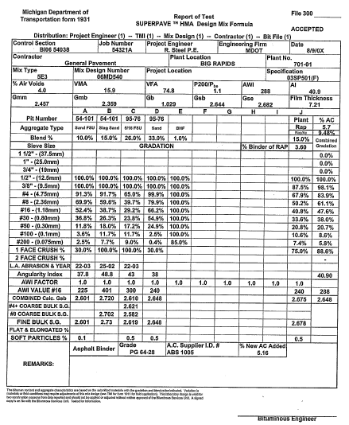
Mix Design Example
Notes:
Mix design must be done incorporating RAP and taking into account the RAP characteristics
15 % RAP mix ( Rap has 3.6 % AC )
Add - 5.16 % new AC - to get 5 .7 % final design AC

Slide 30
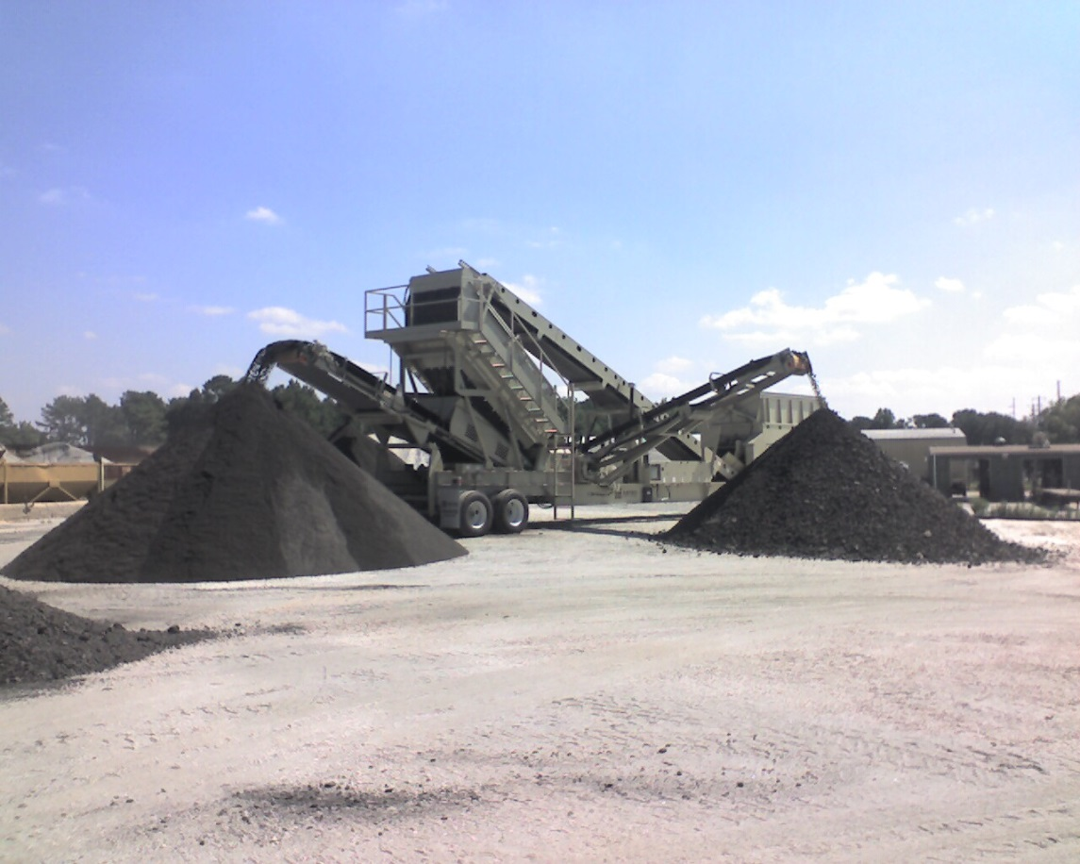
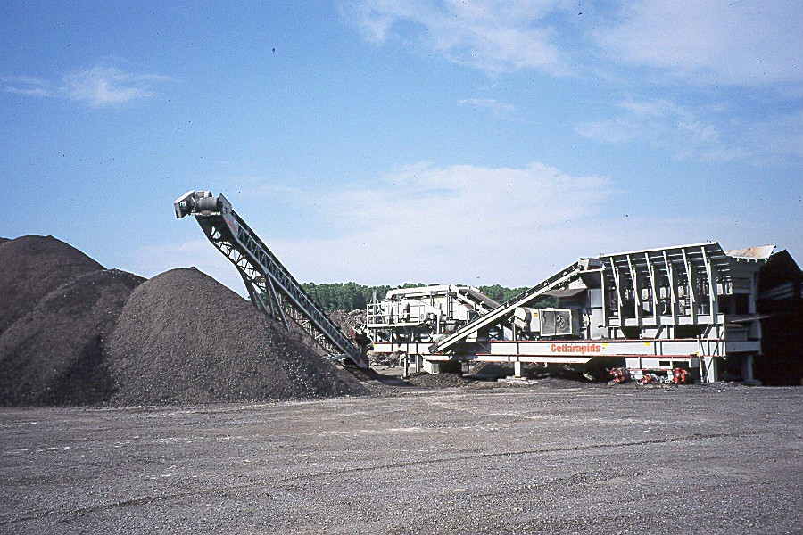
Ability to Meet Volumetrics
Treat RAP as mix component
Challenges: VMA and dust/asphalt ratio
Good processing practices and quality control can be used to overcome this issue
Notes:
RAP has a higher dust content than the other aggregates used in todays asphalt mixes
Has to be managed and controlled just like any other component in the mix in order to meet mix volumetric properties
Good processing practices can be used to overcome this issue
Minimize generating dust in RAP stockpiles
Fractionate RAP for mix design flexibility and gradation control

Slide 31
Recommended Practices for Use of RAP (and RAS)
Test the produced Mix:
(Binder, Gradation)
Contractor Quality Control Tests
Owner Quality Assurance / Acceptance tests
If you have performance concerns:
Consider testing/monitoring other properties
Mix volumetrics (Air Voids, VMA)
Fines to Effective Binder Ratio

Slide 32
Presentation Outline
Decision Making Process
Mix Selection
Rehab of Concrete Pavements
Preventive Maintenance

Slide 33
Rehabilitation of Concrete Pavements
Improve ride quality
Correct surface defects
improve surface drainage
increase surface friction
Delay/prevent structural deterioration
Strengthen pavement structure (rehabilitation)
Notes:
Concrete rubblization followed by an HMA overlay improves ride quality by removing bumps caused by faulting in joints and cracks.
It corrects surface defects in the roadway providing improved surface drainage. The elimination of joints and faults keeps water from ponding as readily. Surface friction is improved by reducing hydroplaning potential.
Deterioration of the structure is slowed by preventing the intrusion of surface water into the old concrete. This is especially important when durability cracking is present in the old PCC. By eliminating the water, the action of freeze-thaw cycles is greatly diminished.
Because a substantial structural overlay is placed on the rubblized concrete, the pavement is strengthened for future traffic.

Slide 34
Rehabilitation Design Factors
Condition of existing pavement
Drainage
Distress
Response to load
Foundation strength/stiffness
Subbase
Subgrade
Future traffic loading
Additional corrections (safety, capacity, etc)
Notes:
As with any pavement design, rubblization requires good site investigation, planning and design in order to be successful.
The type of concrete pavement and its thickness will dictate the effort necessary to fracture the slab. For instance, a thin, plain jointed concrete pavement will require less fracture energy than a thick continuously reinforced concrete pavement.
The adequacy of drainage, types of surface distress and structural integrity of the existing pavement need to be considered in the rubblization and overlay thickness design.
The subgrade type and its stiffness and strength are important considerations. If the PCC slabs are lying directly on a fine-grained soil that is close to saturation, the rubblization process may cause the material to liquify. It is important to carry out a good site investigation to identify possible problems.
The HMA overlay thickness must be such that future traffic demands are met.
Attention must be also be given to other project aspects such as correcting alignments or adding capacity. It is important that details such as maintaining drainage flow are considered in the planning and design stages.

Slide 35
Reflective Cracking
By far, the biggest problem in HMA overlays of PCC pavement
Caused by movement at PCC joints and cracks
Reflective crack
Load-induced movement
HMA
PCC
Slabs Contract
Joint Opens
Slabs Expand
Joint Closes
Notes:
The most common form of distress in HMA overlays of PCC is reflective cracking. This is a result of the concrete slabs contracting and expanding with temperature changes, which cause the joints and cracks to open and close. This opening and closing causes a crack to form in the HMA directly over the opening in the concrete.
Also, if the concrete slabs are not firmly seated on the underlying material, traffic loads going over the joints will cause the joints to move up and down vertically. This movement will cause shearing in the asphalt over the joint and create a reflective crack.

Slide 36
Design Issues
Rate of propagation through overlay
Number of reflected cracks
Rate of deterioration of reflected cracks
Amount of water that can infiltrate through the cracks

Slide 37
Reflection Crack Control Measures
Fabrics
Stress-relieving interlayers
Crack-arresting interlayers
Preoverlay treatments
Slab repair or replacement
Sawing and sealing joints
Increased overlay thickness

Slide 38
Crack Control Effectiveness
Delay the occurrence of cracking
Reduce the number of cracks
Control the crack severity
Provide other benefits
Reduce overlay thickness
Enhance waterproofing capabilities

Slide 39
Fabrics
Overlay
Fabric
Stress concentration
Old pavement
Horizontal opening
Vertical differential
Movement
Subgrade Soil

Slide 40
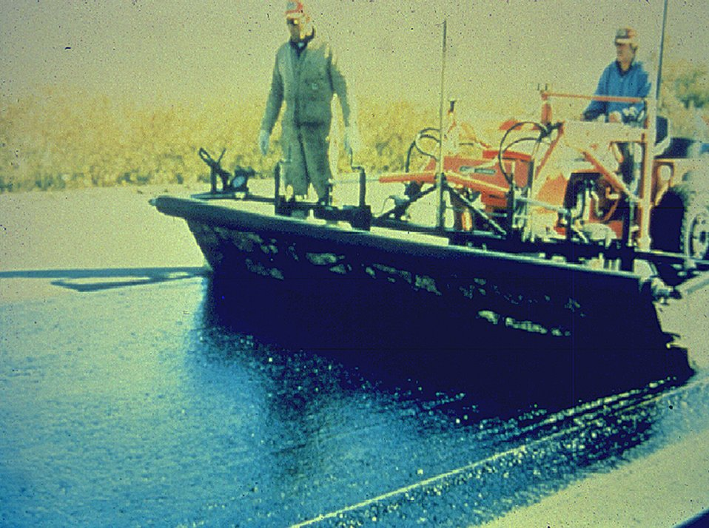
Fabric Application

Slide 41
Pre-overlay Repairs
Slab stabilization
Fractured slabs
Slab repair / replacement
Load transfer restoration

Slide 42
Fractured Slab Techniques
Crack and seat (JPCP)
Break and seat (JRCP)
Rubblize (JPCP, JRCP, CRCP)

Slide 43
Cracking and Seating
Shortens effective slab length
Standard practice in many States
Not “generally” recommended for use on poor subgrades
Design methods (overlay thickness)

Slide 44
Cracking and Seating
Overlay
Good
granular
interlock
Short slab length (~2’)
Cracks
Subbase
Firm Foundation
Subgrade Soil

Slide 45
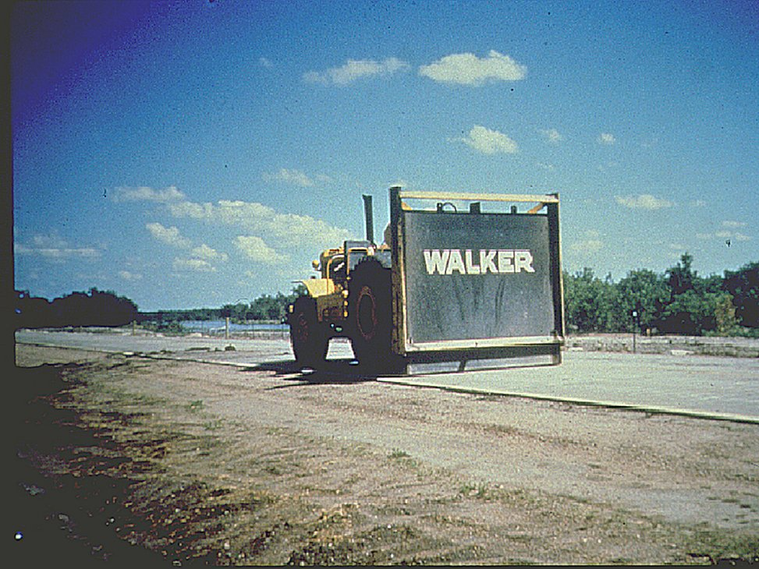
Cracking and Seating

Slide 46
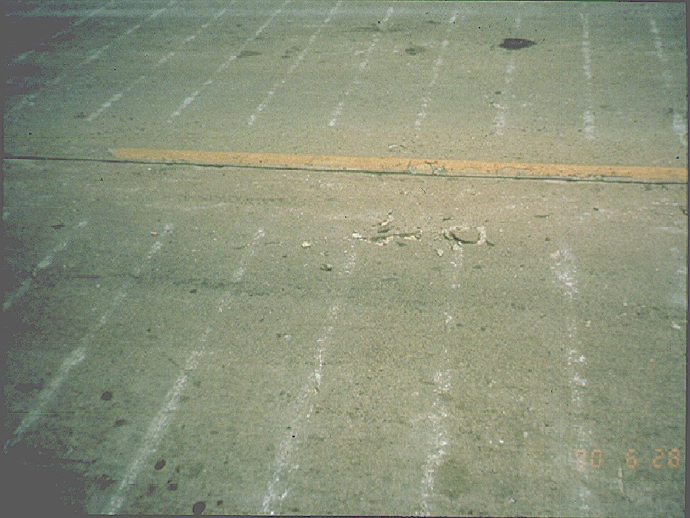
Cracking and Seating

Slide 47
Rubblization
Fracturing:
Eliminates slab action
Destroys bond between concrete and steel
Rubblized base responds as a tightly keyed, interlocked high-density, unbound layer
Layer cannot crack; already fractured
Notes:
Rubblization eliminates slab action by 1) destroying the geometry of the slab and 2) seating the concrete firmly against the underlying subbase or soil. It also breaks the bond between the concrete and any steel present in the slab, eliminating detrimental effects caused by corrosion of the steel and further reducing the ability of the concrete to act as a mass.
The rubblized concrete responds as a tightly packed, high-density granular material. The rough, hard particles provide an internal friction to resist rutting while the lack of tension prevents cracking.

Slide 48
Why Rubblize?
Fracturing PCC to segments less than 9” precludes reflection of:
Joints
Cracks
Faults
Production Rates up to 1 lane-mile/day
Notes:
Fracturing the surface of the concrete to a relatively small size means that features and problems in the old concrete surface such as joints, cracks and faults cannot reappear in the HMA overlay. This prolongs the life of the overlay and helps to ensure a smooth pavement.
Production rates with rubblization are up to 1 lane-mile per day, per rubblizer, much faster than other types of PCC rehabilitation. This means lower construction costs and less inconvenience to road users, giving substance to the slogan “Get In, Get Out, Stay Out.”

Slide 49
Rubblization
Smaller Pieces = Smaller Movement = No Cracking
HMA
PCC
Notes:
Rubblization reduces the size of concrete pieces so that the expansion and contraction causes a minimum of movement. The space between the fractured pieces moves less so that the cracks are not reflected through the surface. And, because the process seats the pieces of concrete, reflection cracking through shearing at the joints does not occur.

Slide 50
Rubblization - Equipment
Notes:
The Resonant Pavement Breaker (RPB) uses a low-amplitude 2000-pound force applied at a frequency of 44 cycles per second to fracture the concrete pavement.

Slide 51
When to Rubblize
Patching > 10%.
Severe D-cracking.
Severe ASR or ACR cracking.
Dowel bar locking
Severe joint deterioration
Persistent faulting.
Notes:
Some general guidelines on when to rubblize concrete pavement include:
When patching is needed in more than 10% of the slab,
When severe durability (D) cracking is present,
Alkali-silica reaction (ASR) or alkali-carbonate reaction (ACR) cracking is present,
When dowel bars have locked up due to corrosion,
When faulting reappears shortly after retexturing the concrete surface.
All these distresses are indications that major systemic problems exist in the concrete pavement, and that a rehabilitation consisting of rubblization with an HMA overlay is viable.

Slide 52
Precaution
Weak soils may make construction difficult.
Option 1
Adjust breaking pattern (12 - 18”) in soft areas.
Use normal seating rolling.
Resume smaller pattern after weak area.
Notes:
It is not unusual to run into occasional soft spots of soil. In these conditions, rubblization may weaken the soils and cause the rubblized particles to punch through the underlying material. When this happens, there are a couple of options which should be immediately considered.
The first option is to reduce the effort in fracturing the slab. This can be done by adjusting the breaking pattern to produce larger pieces. If the softening seems to stop, then use a normal rolling pattern to seat the concrete and resume the original pattern after the soft area.

Slide 53
Precaution
Option 2
Cease rubblization
Define weak area
Remove/replace problem material
Resume normal operations when past weak area
Perform a good soils evaluation prior to construction
Notes:
The next option is to cease rubblization. This should be done if adjusting the breaking pattern does not work. The area of soft soil should be defined to mark the limits. The concrete should be removed along with the problem soil in the local area. Normal rubblization operations can proceed after the soft area.
These types of problems may be reduced significantly if a good soils investigation is performed ahead of construction. Past project records, soils maps and non-destructive testing may provide vital clues to identifying problem areas.

Slide 54
Stress-Absorbing Interlayers
Overlay
Membrane
Stress concentration
Horizontal opening
Old pavement
Vertical differential
Movement
Subgrade Soil

Slide 55
Asphalt Stabilized Crack-Relief Layer (ASCRL)
HMA Overlay
ASCRL High voids
Old pavement
Subgrade
Notes:
Grade lift or ASCRL

Slide 56
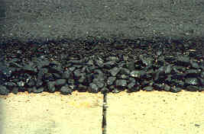
Asphalt Stabilized Crack-Relief Layer (ASCRL)

Slide 57
Asphalt Stabilized Crack-Relief Layer (ASCRL)
HMA Overlay, 3.5” – 4”
ASCRL 3” – 3.5”
Old pavement
Subgrade
Notes:
Grade lift or ASCRL

Slide 58
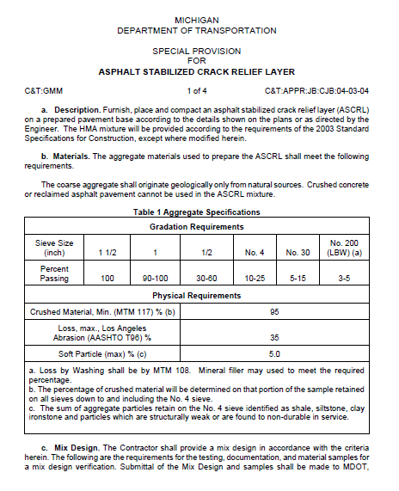
Asphalt Stabilized Crack-Relief Layer (ASCRL)
Notes:
MDOT has a special provision

Slide 59
Asphalt Stabilized Crack-Relief Layer (ASCRL)

Slide 60
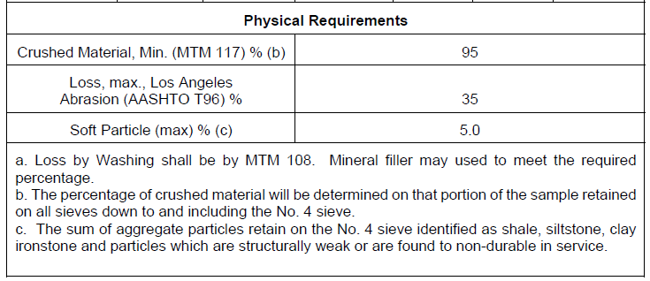
Asphalt Stabilized Crack-Relief Layer (ASCRL)

Slide 61
Asphalt Stabilized Crack-Relief Layer (ASCRL)
Mix Design
Asphalt Binder – PG 64-28 with 0.5% liquid antistrip additive
Asphalt content – 3 to 4 %
Surface Coating – 100 % without excessive draindown (max 0.30 %)
Minimum Asphalt film thickness - 9.0 microns
Moisture sensitivity (AASHTO T283)

Slide 62
Asphalt Stabilized Crack-Relief Layer (ASCRL)
Construction
Placed in a single layer
Compaction – steel – wheeled tandem roller (1.0 ton per foot of drum length)
Static mode only
Minimum of three passes (down and back)
Compaction test strip may be required (minimize breakage of Agg.)

Slide 63
Asphalt Stabilized Crack-Relief Layer (ASCRL)
MDOT Projects to Date
Project | # of Jobs | Length (miles)
ASCRL | 25 | 105
Started in 2001
All are performing very well

Slide 64
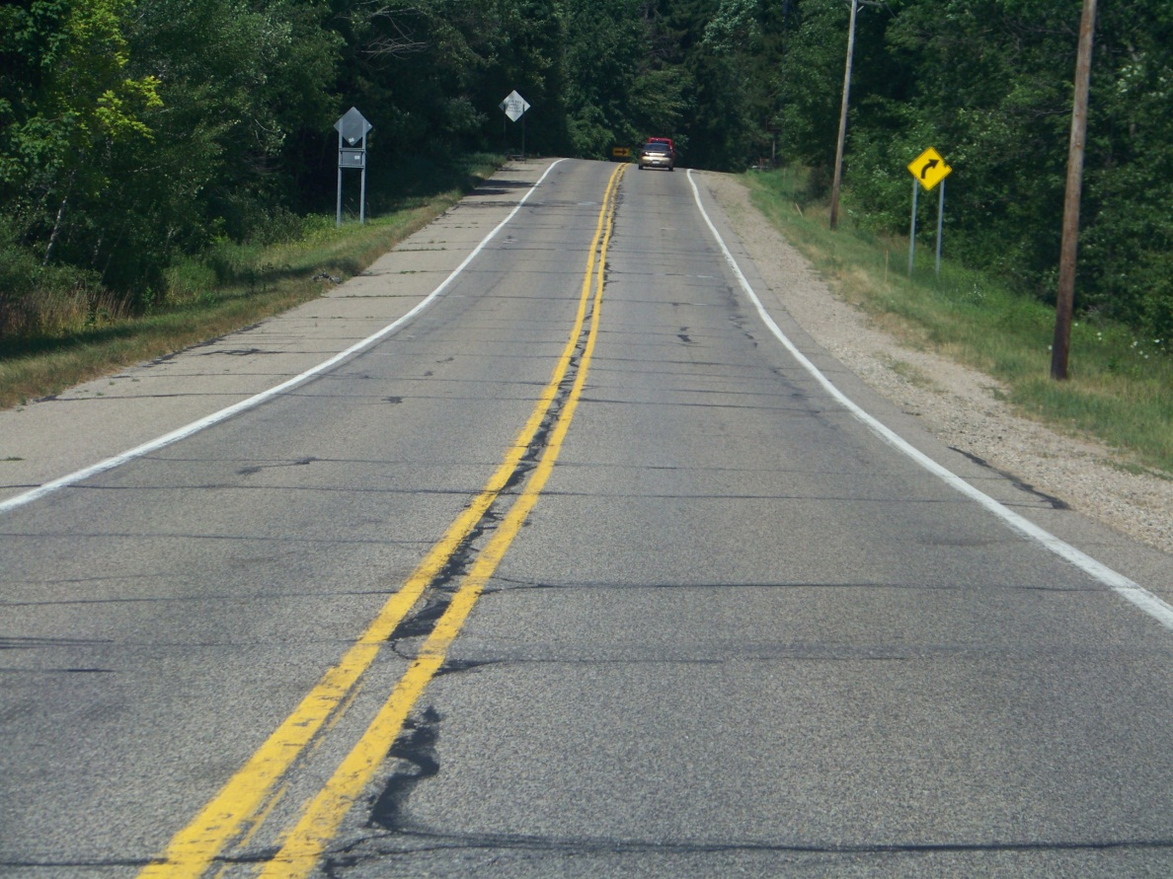
Asphalt Stabilized Crack-Relief Layer (ASCRL)
M-21, Before Construction
Notes:
This section of M-21 was going to be done in 2012, date of pic

Slide 65
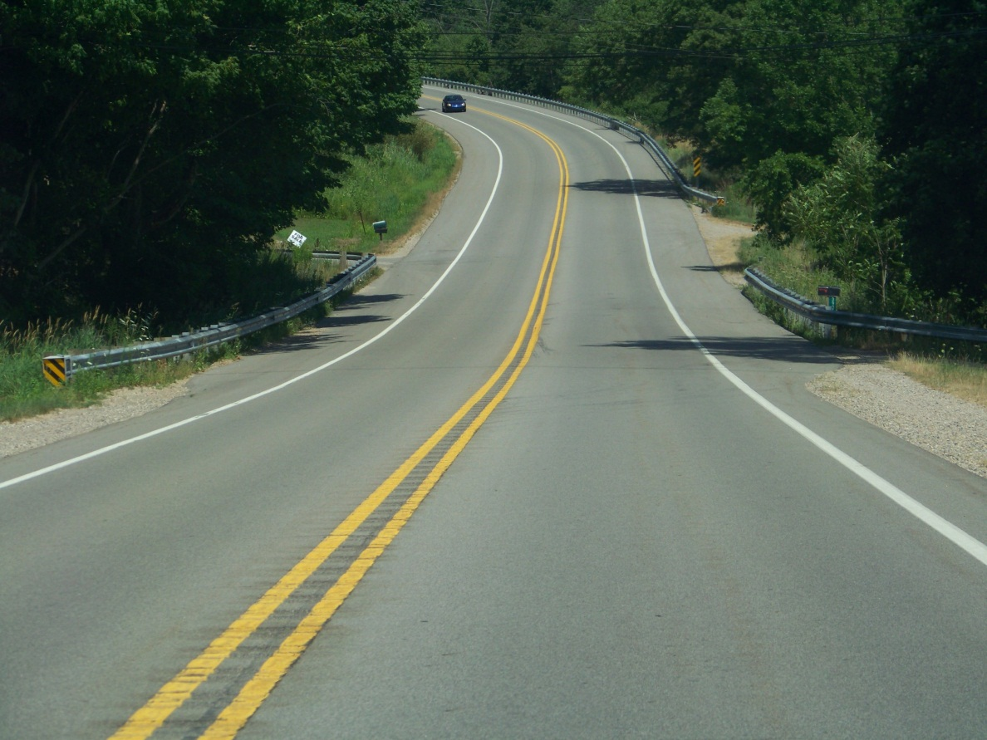
Asphalt Stabilized Crack-Relief Layer (ASCRL)
M-21, 3 years old
Notes:
This section of M-21 was done in 2009, pic is from 2012, just down the road from previous slide pic

Slide 66
Sawing and Sealing Joints
Concede appearance of reflection cracking
Objective: control rate of deterioration
Reduces spalling of reflection cracks
Candidates should have well-defined joints
Sawcut must be directly above underlying joint

Slide 67
Sawing and Sealing Joints
Joint reservoir
Sealant
Overlay
Reflection crack
Initial sawcut
1/3 depth
Horizontal opening
Old pavement
Vertical differential movement
Subgrade

Slide 68
Sawing and Sealing Joints

Slide 69
Increased Overlay Thickness
Delays occurrence of reflection cracking
Cracks propagate about 1 in. per year
Reduces temperature fluctuations in underlying pavement

Slide 70
Presentation Outline
Decision Making Process
Mix Selection
Rehab of Concrete Pavements
Preventive Maintenance

Slide 71
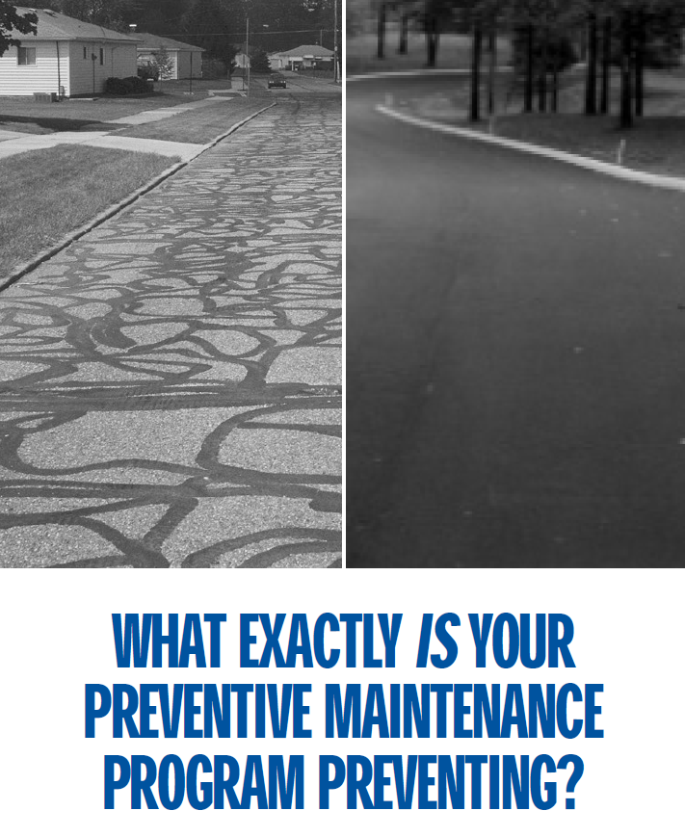
Preventive Maintenance

Slide 72
Preventive Maintenance
Preventive maintenance is a planned strategy of cost effective treatments to an existing roadway system and its appurtenances that preserves the system, retards future deterioration, and maintains or improves the functional condition of the system without substantially increasing structural capacity.
Notes:
The Capital Preventive Maintenance (CPM) Program was established to preserve the structural integrity and extend the service life of the state trunkline network through a series of construction contracts. The program was initiated by the Michigan Department of Transportation's Maintenance Division (currently the program resides in the Construction and Technology Division) in 1992, in cooperation with the Federal Highway Administration. Funding for the program is a combination of federal and state transportation dollars.

Slide 73
Preventive Maintenance
Standard Capital Preventive Maintenance Treatment
Pavement Seal
HMA Crack Treatment
Overband Crack Fill- Pretreatment
Chip Seals
Micro-surfacing
Ultra-Thin HMA Overlay-Low & Medium Volume (<1″ thick)
Shoulder Fog Seal
Paver Placed Surface Seal
Notes:
The CPM program has two subgroups, Pavement Sealing and Functional Enhancements, to encourage a balanced CPM strategy that will complement the Regions Road Rehabilitation/Reconstruction strategy. A discretionary budget and an emerging technologies budget also exist to supplement either group to achieve the most cost effective preventive maintenance strategy. The discretionary budget can be used for pavement sealing, functional enhancements, or emerging technologies. Emerging technologies are new treatments that are promising, but whose performance and cost effectiveness are unknown.

Slide 74
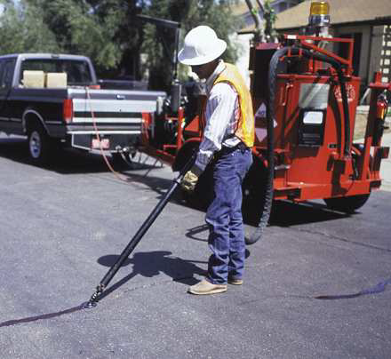
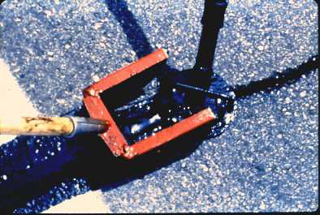
Preventive Maintenance
Crack Treatment

Slide 75
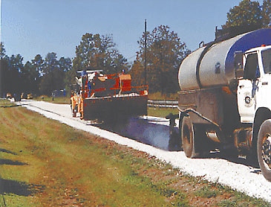
Preventive Maintenance
Chip Seal

Slide 76
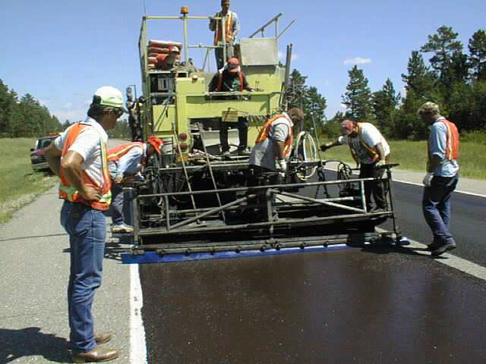
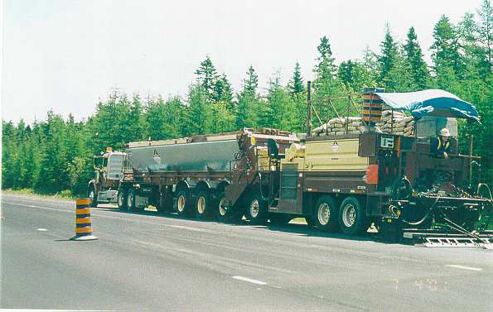
Preventive Maintenance
Micro-surfacing

Slide 77
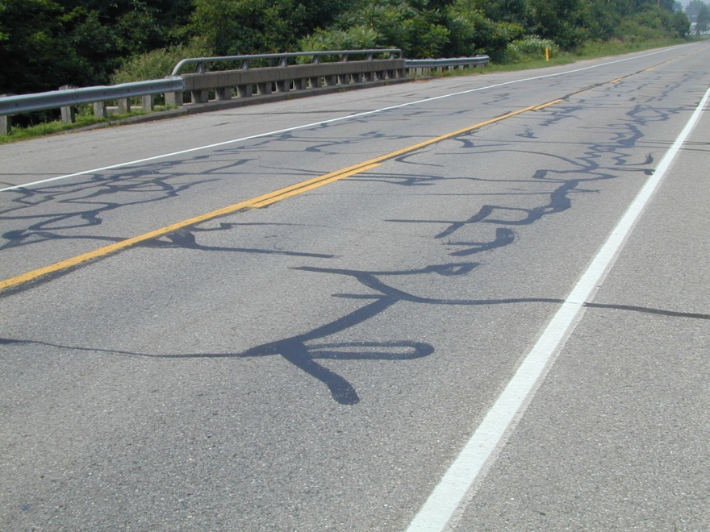
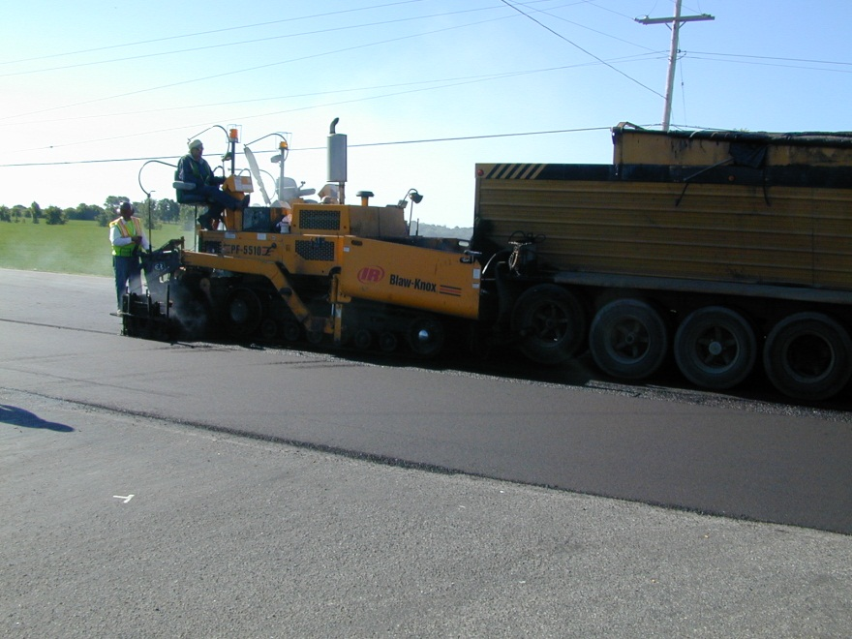
Preventive Maintenance
HMA Ultra-Thin
High Value Pavement Enhancement
Extends pavement life Protects pavement structure Restores pavement smoothness
Notes:
HMA Ultra-Thin is the High value pavement enhancement.
It will extend the life of your pavement,
Protect the pavement structure,
And restore pavement smoothness.

Slide 78
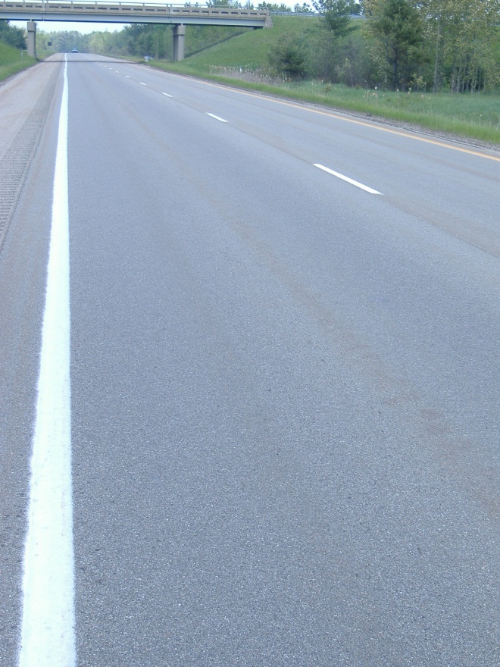
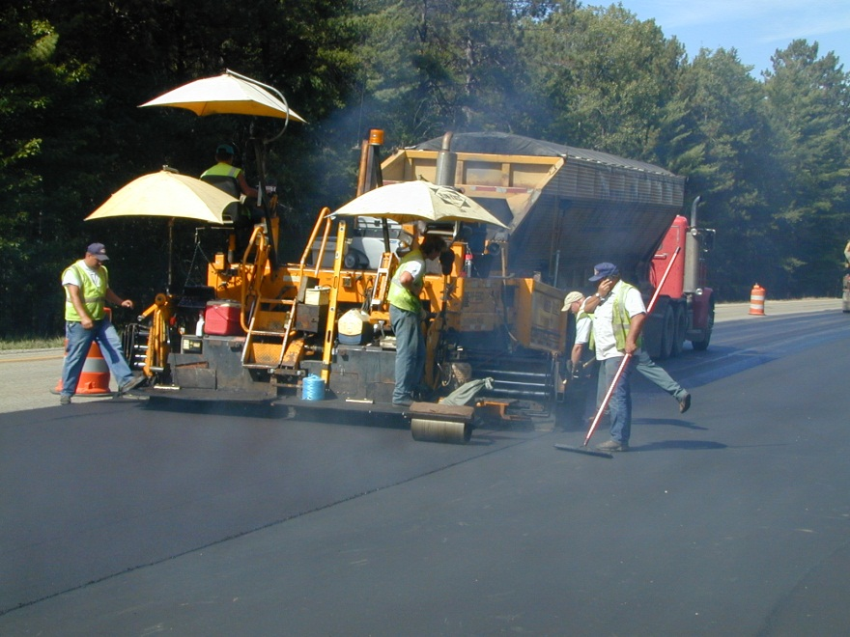
HMA Ultra-Thin
BENEFITS
• 5-9 year life extension
• Seals pavement to delay further deterioration
• Improve ride quality
• Minimize or eliminate structure adjustments
• Reduce noise
• Improve drainage
• Ease of construction, standard paving operation
• Minimal construction time
Notes:
BENEFITS
• 5-9 year life extension
• Seals pavement to delay further deterioration
• Improve ride quality
• Can improve skid resistance
• Maintain existing gutter pan
• Minimize or eliminate structure adjustments
• Reduce noise
• Improve drainage
• Ease of construction, standard paving operation
• Minimal construction time

Slide 79
HMA Ultra-Thin
Preventive Maintenance Treatment Cost Comparison
Treatment | $/syd | Cost/mile (24’ wide) | MDOT Life extension range (years)* | MDOT Life extension range average (years)* | Cost/mile* per year
Double chip seal | $3.13 | $44,069 | 3-5 | 4 | $11,017
Micro-surface | $3.02 | $42,520 | 3-5 | 4 | $10,630
Ultra-thin low | $3.09 | $43,505 | 5-9 | 7* | $6,215
Ultra-thin med | $2.83 | $39,845 | 5-9 | 7* | $5,692
Ultra-thin high | $3.29 | $46,321 | 5-9 | 7* | $6,617
*Average Life Extension estimated by APAM
Unit Prices based on MDOT Information (thru Jan. 2015)
Notes:
HMA Ultra-Thin is Your Best Value for Preventive Maintenance dollars!
As You can see, the cost/mile per year is much lower than that of chip seal or microsurfacing.

Slide 80
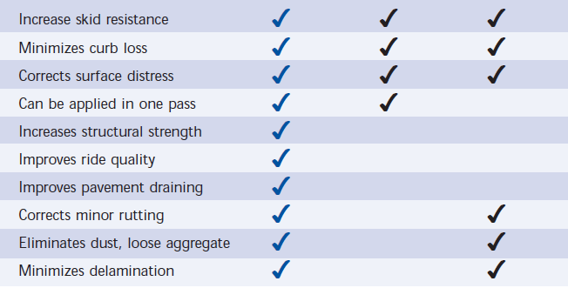
HMA Ultra-Thin
HMA UT Chip Seal Microsurfacing

Slide 81
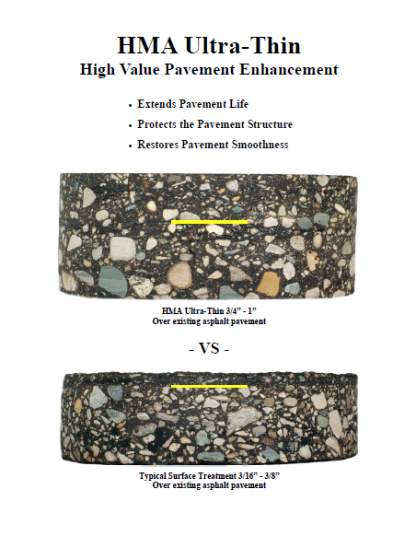
HMA Ultra-Thin
Advantages:
Adds structural value
Very smooth riding surface
Improved ride quality
No excess stone buildup
No broken windshields from loose aggregate

Slide 82
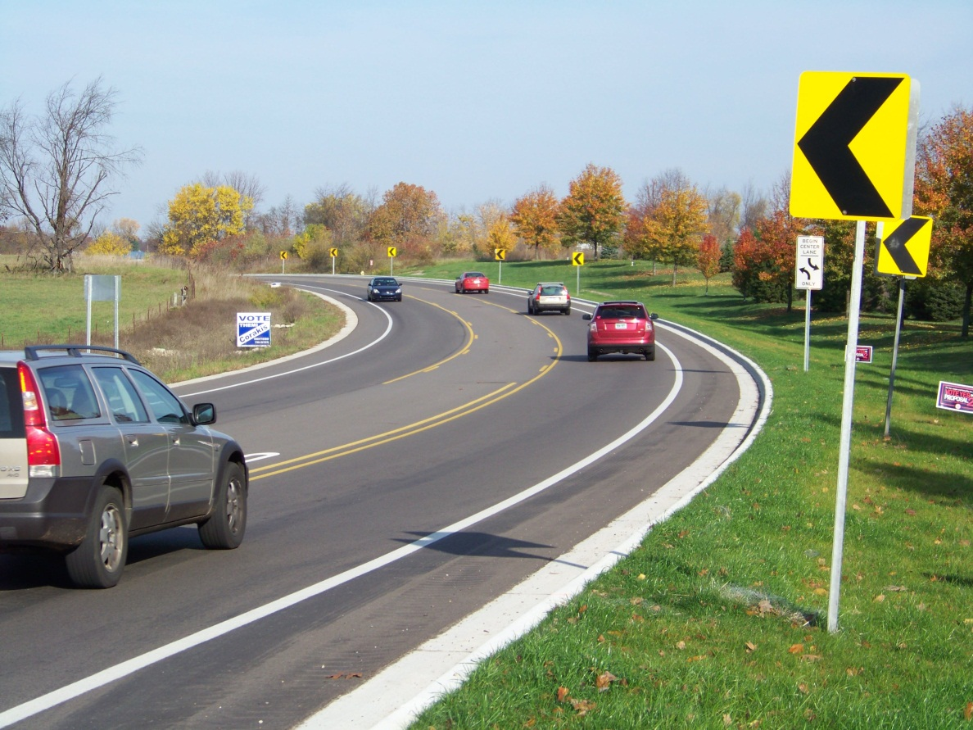
Project Scoping
Questions?

