Slide 1
2015 Local Roads Workshop Gaylord March 12, 2015

Slide 2
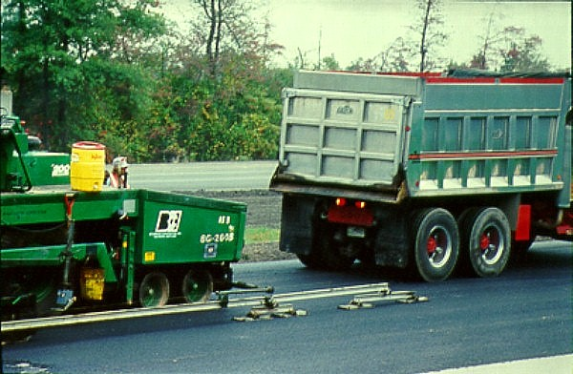
Best Practices for HMA Construction

Slide 3
HMA Construction Inspection
Sound inspection practices during construction are vital to obtain quality
Both Agency and Contractor are responsible
Process control and acceptance procedures alone will not ensure quality
Key components of Inspection are:
Enforcement of specifications
Ensure good practices are being used
Observation of materials and workmanship

Slide 4
HMA Construction Inspection

Slide 5
What is Quality?

Slide 6
Definition of Quality for HMA
How do we define Quality?
Meets Agency mixture specifications
Meets Agency density specifications
Smooth riding surface
Uniform texture and appearance
Obtains expected service life
Long Lasting asphalt pavement

Slide 7
HMA Construction Inspection
Responsibilities
Represent the owner’s interests
Keep daily construction diary
Monitor ambient air and mat temperatures
Track tonnage with truck tickets
Calculate yield
Monitor compaction with nuclear or non-nuclear gauge
Observe materials and workmanship
Make sure that good practices are being used

Slide 8
Routine Duties of Inspector
Usually spelled out in specifications
Checking yield/thickness of materials being placed
Adhering to weather and temperature limitations
Checking mix and mat temperature
Acceptance testing of final density

Slide 9
Temperature and Weather Limitations
MDOT Temperature and Weather Limitations
Min temp 35 deg. F, min. 200 lbs/syd
Min temp 40 deg. F, min. 120 lbs/syd
Min temp 50 deg. F, any course

Slide 10
Min. and Max. Mix Temperatures
Notes:
MDOT will reject loads with a mix temperature either below 250 deg. F, or greater than +/- 20 deg. F from the recommended maximum mixing temperature specified by the binder producer at the time of discharge from behind the screed.

Slide 11
Temperature and Weather Limitations
Why does it matter if the mix is too cold?
Because the mix stiffens as it cools. This makes it difficult to obtain proper roadway compaction.
Proper roadway compaction is probably THE most important factor in determining the logevity of the roadway. Every effort must be made to obtain the target density during the compaction process.

Slide 12
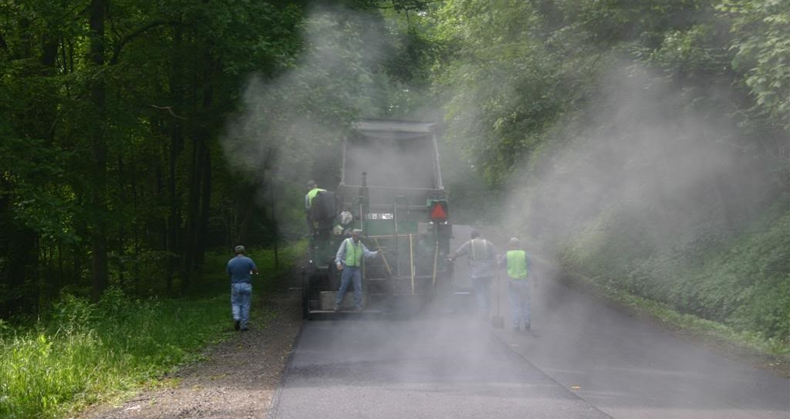
Temperature and Weather Limitations
What about maximum mix temperature?
Notes:
MDOT will reject loads with a mix temperature either below 250 deg. F, or greater than +/- 20 deg. F from the recommended maximum mixing temperature specified by the binder producer at the time of discharge from behind the screed.

Slide 13
Temperature and Weather Limitations
Why does it matter if the mix is too hot?
Because the lighter fractions of the asphalt binder evaporate at higher temperatures.
This makes the remaining binder stiffer, and causes early aging of the binder. Aged binder tends to be more brittle, and more suseptable to cracking.

Slide 14
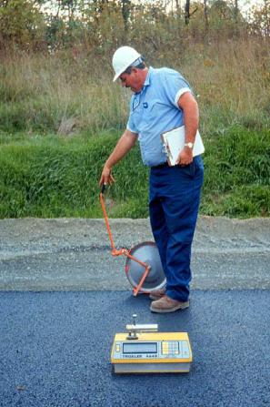
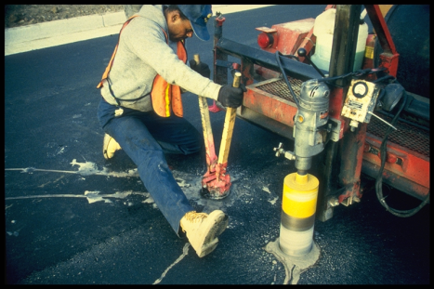
Density Acceptance
Measuring Density
Using cores . . .
or density gauge

Slide 15
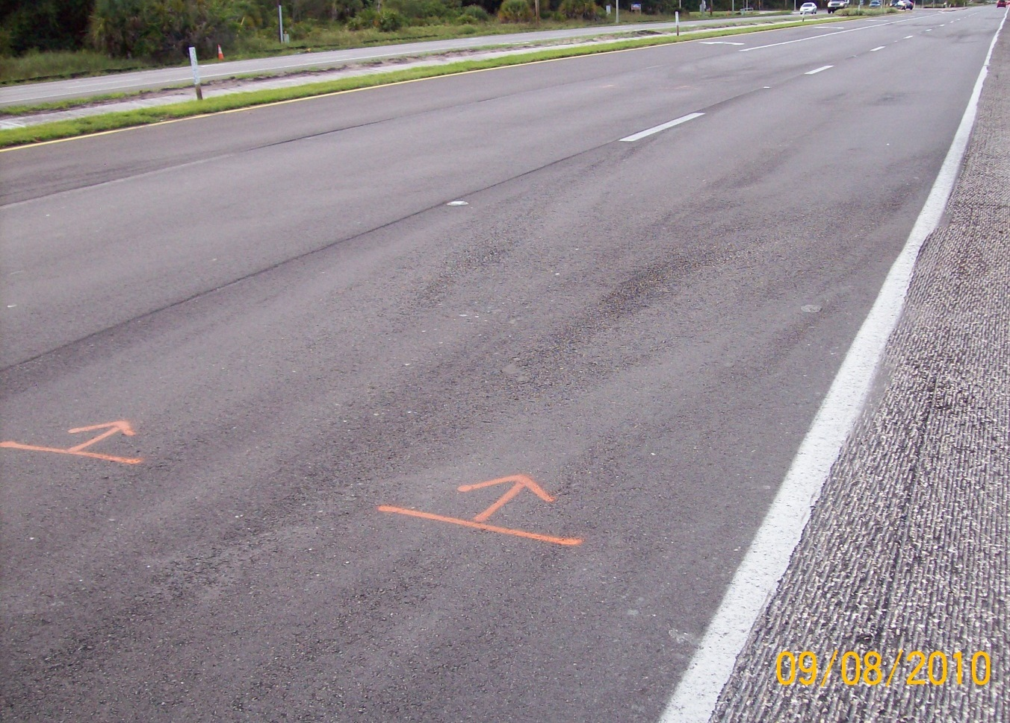
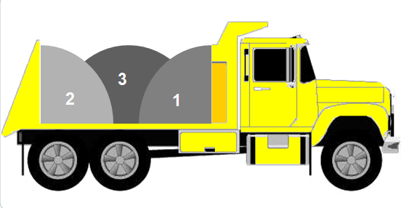
Watch for Segregation
Truck-end segregation is caused by segregation in the truck transferred to the paver.
Make sure the trucks are being loaded in multiple drops!

Slide 16
Best Practices
Hauling
Provide a steady flow of material to the paving operation
Deliver mix at consistent and correct temperature
Paving
Continuous operation (keep paver moving)
Compaction
Compact mix when it is hot

Slide 17
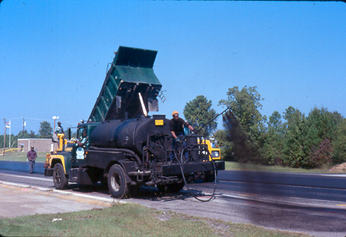
Surface Prep – Good Practice?

Slide 18
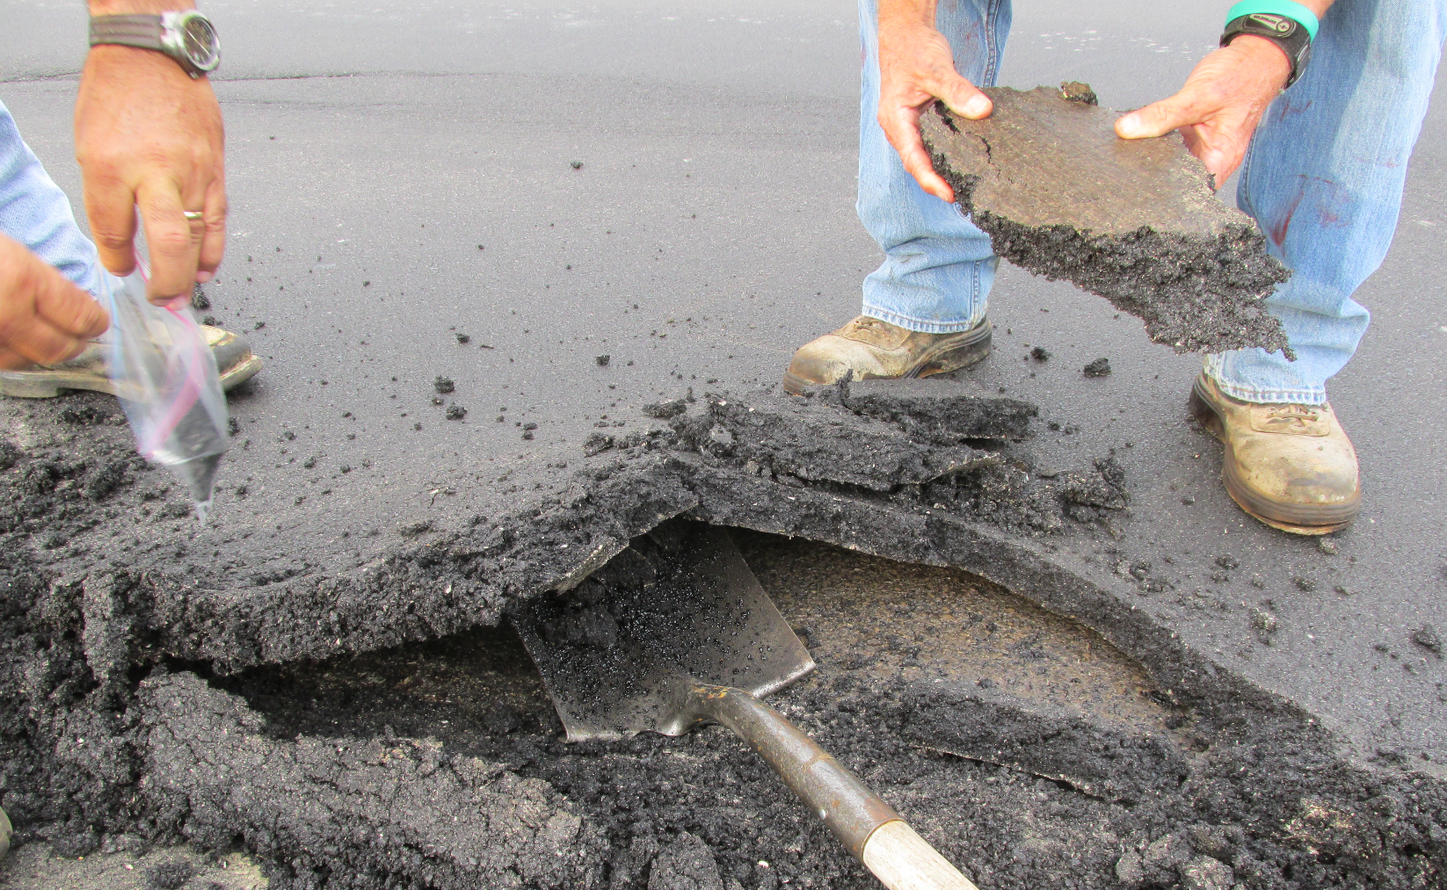
Poor Tack Application

Slide 19
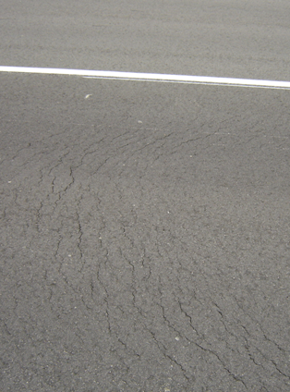
Tack Coat
Why do we use Tack Coat?
To promote the bond between old and new layers.
To prevent slippage between layers
To provide an additional moisture barrier, especially when applied along transverse and longitudinal vertical surfaces
MS-22
5-10

Slide 20
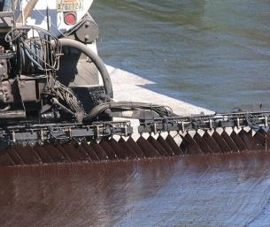
Tack Coat
SS-1, but also SS-1h, CSS-1, CSS-1h, CRS-2, or straight binder
Clean before applying
Coat surfaces that will contact new HMA
Watch accidental pick-up
Tracking
Do not apply:
In cold or windy weather
Or on wet surfaces with free water

Slide 21
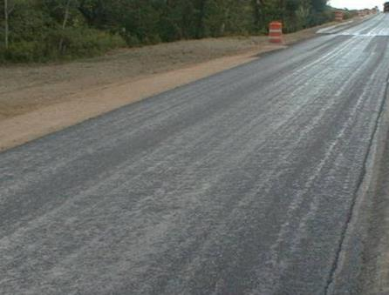
Tack Coat
Original emulsion is often diluted at 1:1 ratio
Ehance sprayability
Apply at a rate of 0.05 to 0.15 gal/yd²
Adjusted based on surface texture
Less on smooth
More on rough)
Make sure tack breaks before paving
Advice: Don’t allow the tack too far in advance of paving
Wind blown dust & debris minimizes its effectiveness

Slide 22
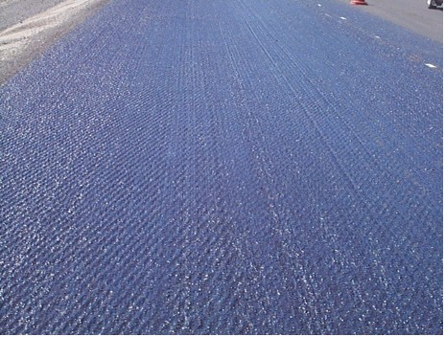
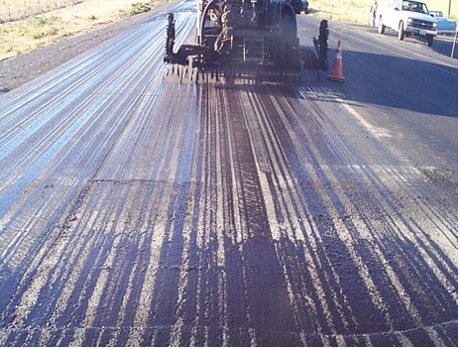
Tack Coat
GOOD
Even uniform coverage
No puddles
No stripes
BAD
Uneven coverage
Clogged nozzles / improper orientation
Stripes are clearly visible

Slide 23
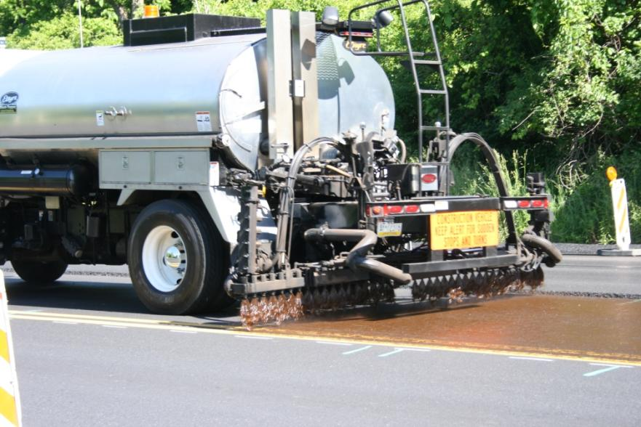
Tack Coat
Full width of mat to minimize movement of unsupported edge
Photo Courtesy of Jim Scherocman
Notes:
The application of a properly cured tack coat (PG grade or emulsion) is critical to minimizing the lateral movement of the unsupported edge. It is important the tack coat cover the full width of the lane being placed. In the photo above, the tack was placed beyond the edge of the mat, which is OK too.

Slide 24
HMA Construction Inspection
Sound inspection practices during construction are vital to obtain quality
Both Agency and Contractor are responsible
Process control and acceptance procedures alone will not ensure quality
Key components of Inspection are:
Enforcement of specifications
Ensure good practices are being used
Observation of materials and workmanship

Slide 25
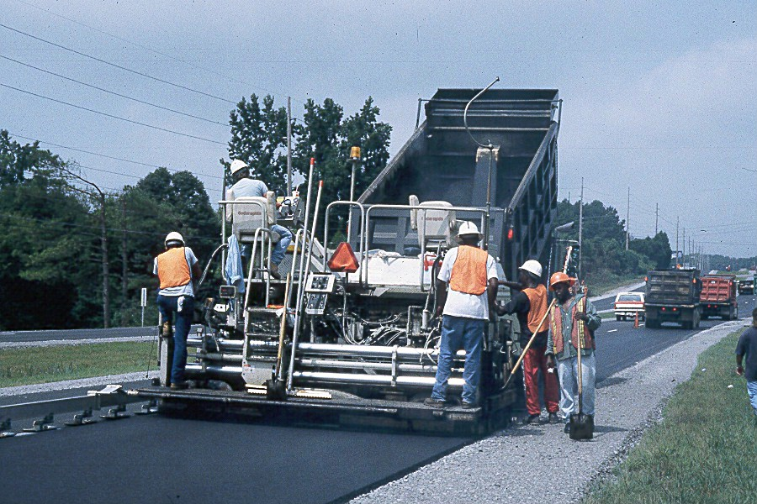
Best Practices for HMA Construction
Questions?

