Slide 1
Transportation Revenue and Sales Tax Ballot Proposal
Director Kirk Steudle

Slide 2
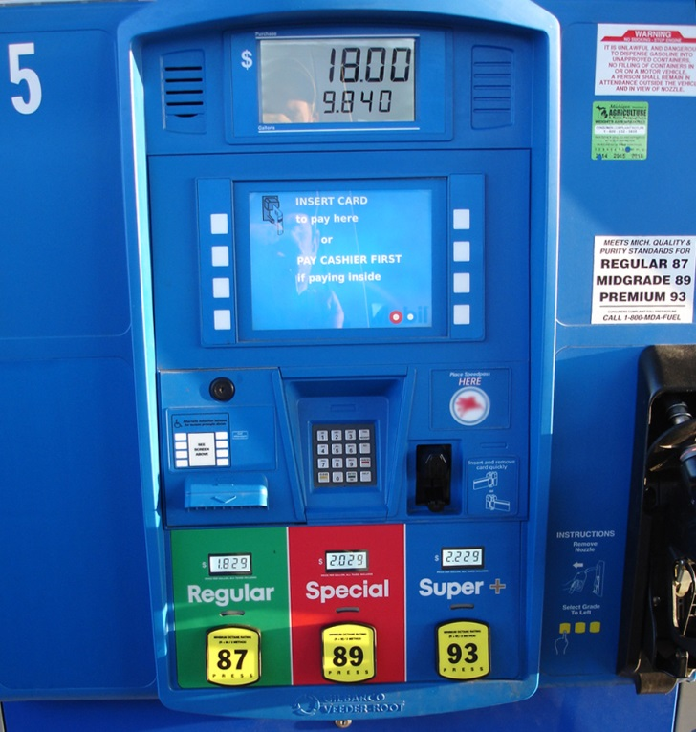
What would the proposed changes do?
All taxes paid at the pump would go to transportation and sales tax goes to schools & cities.
2

Slide 3
Enacted 2015 Transportation Package
Fuel tax increase
Tax Rate for Gasoline & Diesel the same at 14.9%, although prices vary
Gasoline : 19 to 41 cents
Diesel fuel: 15 to 46 cents
New Diesel-equivalent tax on CNG
Remove 6% sales tax from fuel
Registration fee increase of about 30% for:
New cars starting in 2016
Trucks over 26,000 lbs.
Takes effect over 3 to 14 years
3

Slide 4
Impact for Transportation Agencies
$1.2 billion/year more for MTF
39% to county roads; 22% to city streets
Grows with consumer prices; not more than 5₵/year
Road-agency distributions rise by 60% in 2018
$112 million/year for CTF by 2018
No change to formula
4

Slide 5
Impact for Other Public Agencies
$300 million/year more for School Aid Fund
$100 million/year more for revenue sharing
$20 million/year more for DNR marinas and ORV trails
Additional funding for community colleges
5

Slide 6
Impact for Individual Taxpayers
Sales tax rises from 6 to 7%
Fuel tax increases; sales tax removed from fuel
Tax at pump rises up to 12₵/gallon in Oct. 2015
Earned-income tax credit increased from 6 to 20% of federal credit; eligibility is broadened
Registration fee increase of about 30% on new cars starting in 2016
Registration fee on hybrid-drive cars increased by $25/year
Registration fee on electric cars & plug-in hybrids increased by $75/year
6

Slide 7
Impact for Businesses
Diesel fuel tax is increased; sales tax is removed from Diesel fuel
Total tax on Diesel fuel rises 12₵/gallon in October, 2015
No registration fee increase on medium trucks
Registration fee rises by $600/year on typical heavy truck
Sales tax rises on retail purchases
Enlarged assistance to small-business development
7

Slide 8
Taxpayer Protection & Transparency
Increase use of pavement warranties by local agencies, where possible
County road agencies required to use competitive bidding for projects of a certain size
Townships contributing more than 50% to cost of county road project may require competitive bid
Performance-driven maintenance contracting by 7 largest road agencies
8

Slide 9
All proposed changes are tied to the outcome of the sales tax ballot referendum.
9

Slide 10
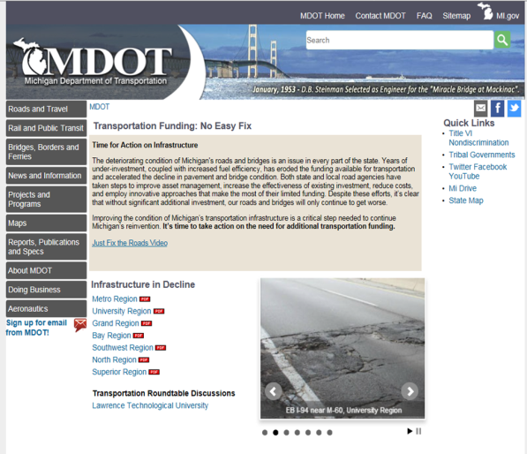
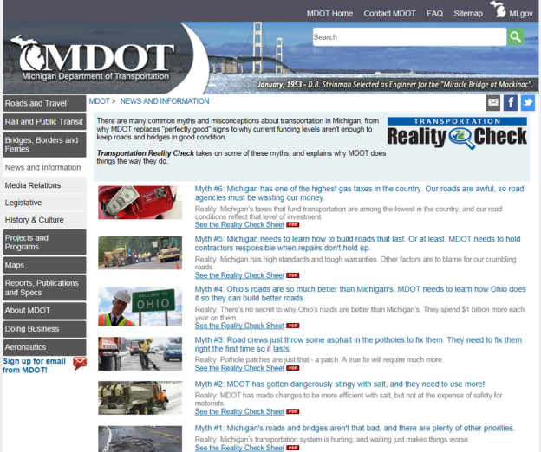
MDOT Communication Tools
www.michigan.gov/roadfunding
www.michigan.gov/realitycheck
10

Slide 11
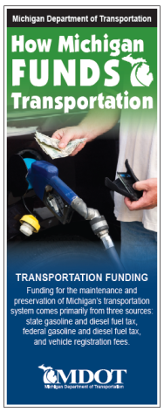
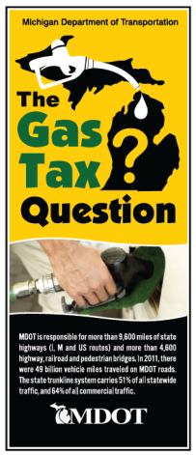
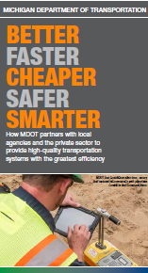
Brochures
Making Michigan Move: Our Roads, Mobility & Economy
How Michigan Funds Transportation
Michigan Gas Tax Revenue
Pavement – Designing, Building, and Maintaining Michigan State Highways
Which Roads to Fix?
Making Michigan Soar, Our Airports Connecting Michigan to the World
Truck Weights in Michigan
MDOT Efficiencies
11

Slide 12
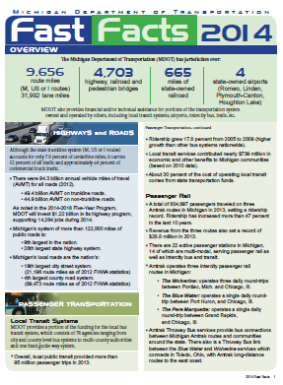
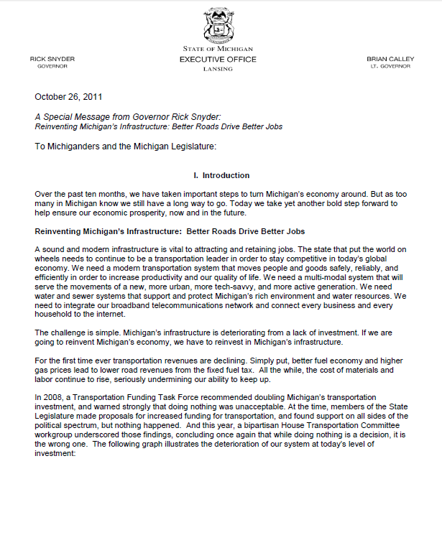
White Papers
Plain Facts about MDOT’s Revenue, Cost-Cutting & Investment
Special Message on Revitalization of Michigan’s Deteriorating Infrastructure
Fast Facts
Michigan’s Truck-Weight Law & Truck-User Fees
12

Slide 13
Questions?

